Slide 1
Topic 1 Stoichiometric relationships
IB CHEMISTRY

Slide 2
1.1 Introduction to the particulate nature of matter and chemical change
OBJECTIVES
• Atoms of different elements combine in fixed ratios to form compounds, which have different properties from their component elements.
• Mixtures contain more than one element and/or compound that are not chemically bonded together and so retain their individual properties.
• Mixtures are either homogeneous or heterogeneous.
• Deduction of chemical equations when reactants and products are specified.
• Application of the state symbols (s), (l), (g) and (aq) in equations.
• Explanation of observable changes in physical properties and temperature during changes of state.

Slide 3
Law vs theory
Both are developed from experiments. Both have exceptions. Both can be modified or rejected.
Theory: An explanation that provides an understanding across a range of phenomena and disciplines.
Law: A description of regular patterns of behavior.

Slide 4
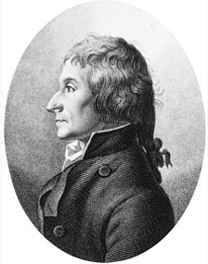
Law of definite proportions
‘A compound always contains the same proportion of elements by mass’
Joseph Louis Proust, French chemist
1794 showed experimentally that artificial and natural copper carbonate had the same proportion of weights between Cu, C, and O.

Slide 5
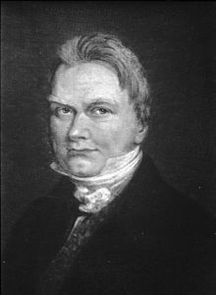
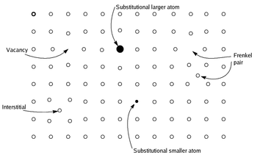
But... what about this compound?
Berzelius a Swedish chemist disagreed with Proust.
Non-stoichiometric compounds (mainly inorganic solids and polymers) as well as isotopes form exceptions to the rule
Eg. FeO is usually Fe_{0.84}O due to Fe in different states (Fe²⁺ and Fe³⁺)

Slide 6
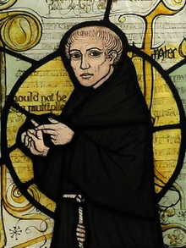
Principle of Occam’s razor
William of Ockham was and English monk (1287-1347 CE).
‘A theory should be as simple as possible while maximizing explanatory power.’
(Shaving away the unnecessary)
Why did Proust win out over Berzelius?

Slide 7
Terminology
Element: A substance composed of atoms having an identical number of protons in each nucleus.
Atom: Smallest part of an element
Compound: 2 or more elements chemically bonded together
Mixtures: Contain more than one element an/or compound that are not chemically bonded together and so retain their individual properties. Two types:
Homogenous – have uniform properties
Heterogenous – have non-uniform properties

Slide 8
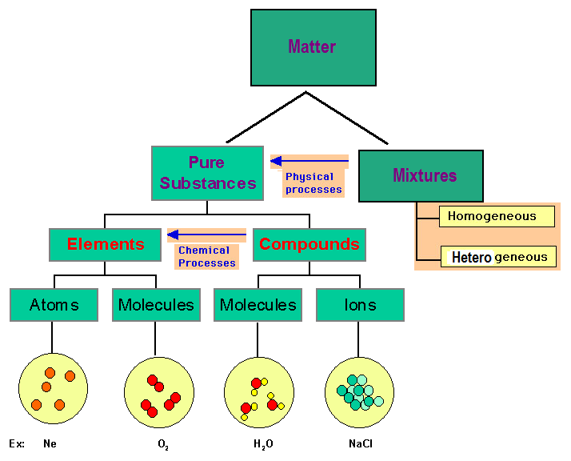

Slide 9
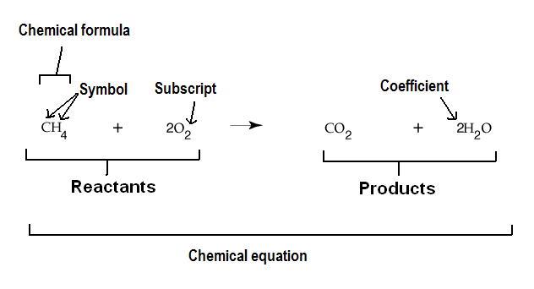
Terminology
Solid (s), Liquid (l), Gas (g), Aqueous (aq) – dissolved in water

Slide 10
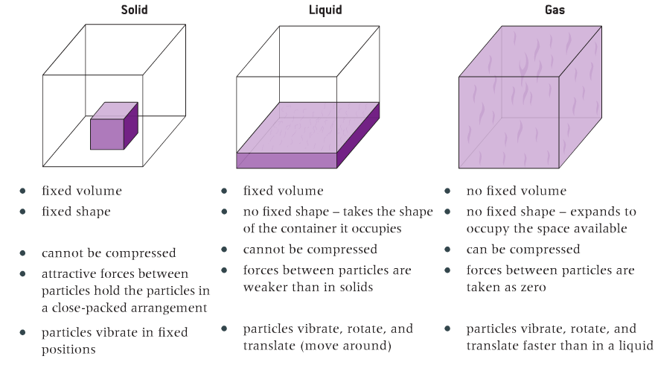
States of matter

Slide 11
Changes of state
Vaporization (boiling vs evaporation)
melting
freezing
condensation
deposition
sublimation

Slide 12
Heating curves
SI unit for temperature is the kelvin (K) which is °C + 273.
150
100
50
0
-50
Energy added at phase change goes into breaking interparticle forces NOT raising temperature
Time/s
This flat line demonstrates the substance is pure

Slide 13
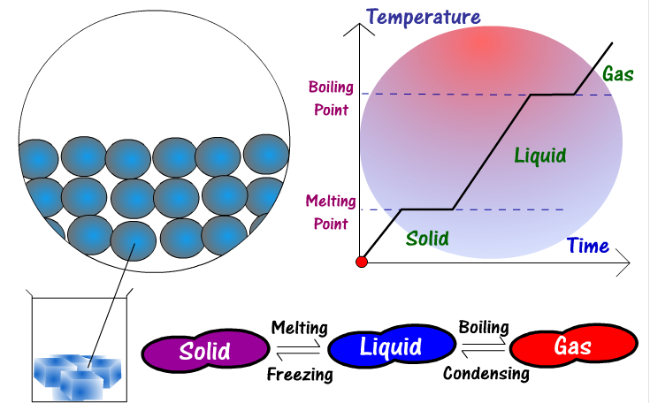

Slide 14
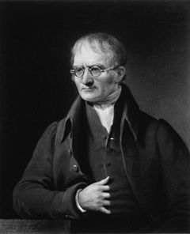
Law of multiple proportions
‘If two elements form more than one compound between them, then the ratios of the masses of the second element which combine with a fixed mass of the first element will be ratios of small whole numbers’ eg. CO and CO₂
John Dalton, English chemist
An improvement built upon Proust’s law of definite proportions and Lavoisier’s law of conservation of mass. These three laws then then form the basis for chemical formulae, names, and stoichiometry!
Notes:
Eg CO and CO2,

Slide 15
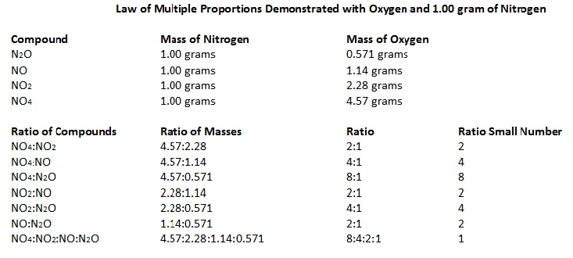
Experimental evidence for stoichiometry:

Slide 16
Polyatomic ions
Ions are atoms with a positive (cations) or negative (anions) charge. Polyatomic ions are covalent molecules with a charge that act as a unit in ionic compounds.
These must be memorized! (list on next slide)
(You will learn how to work these out soon).

Slide 17
Polyatomic ions – the list
Ammonium NH₄⁺
Carbonate CO₃²⁻
Hydroxide OH⁻
Nitrite NO₂⁻
Nitrate NO₃⁻
Sulphite SO₃²⁻
Sulphate SO₄²⁻
Phosphite PO₃³⁻
Phosphate PO₄³⁻
Nitrous acid HNO₂
Nitric acid HNO₃
Sulphurous acid H₂SO₃
Sulphuric acid H₂SO₄
Phosphorous acid H₃PO₃
Phosphoric acid H₃PO₄

Slide 18
Naming covalent compounds
Covalent compounds are formed by sharing electrons. To name these compounds you must add prefixes to show how many atoms are in the formula. You know it is covalent because it will be a non-metal combined with a non-metal.
Add prefixes to all atoms, but omit mono- for the first element. Add –ide to the last element.
Eg. CO = carbon + oxygen = carbon monoxide

Slide 19
Naming ionic compounds
Ionic compounds are formed from the attraction of positive ions (cations) and negative ions (anions). To name these compounds, find the charges and balance the charges. You know it is ionic because it will be metal combined with a non-metal.
The cation comes first the anion comes second.
Eg. NaCl sodium chloride
Charges are already balanced (+1 + -1 = 0)

Slide 20
Balancing equations
1. Make a table to list out the elements on the left and right hand side of the equation
2. Begin with the most complicated compound and balance the equation for this.
Left |  |  | Right
C | H | O | C | H | O
6 | 14 | 2 | 1 | 2 | 3
C₆H₁₄ + O₂ → CO₂ + H₂O
Left |  |  | Right
C | H | O | C | H | O
6 | 14 | 2 | 1 | 2 | 3
 |  |  | 6 |  | 13
C₆H₁₄ + O₂ → 6CO₂ + H₂O

Slide 21
Left |  |  | Right
C | H | O | C | H | O
6 | 14 | 2 | 1 | 2 | 3
 |  |  | 6 | 14 | 13
 |  |  |  |  | 19
C₆H₁₄ + O₂ → 6CO₂ + 7H₂O
3. Finish by balancing the least complicated compound.
Left |  |  | Right
C | H | O | C | H | O
6 | 14 | 2 | 1 | 2 | 3
 |  | 19 | 6 | 14 | 13
 |  |  |  |  | 19
C₆H₁₄ + 19/2O₂ → 6CO₂ + 7H₂O

Slide 22
4. Get rid of any fractions by multiplying by the denominator.
5. Double check to ensure it is balanced and the numbers are the lowest common factor.
C₆H₁₄ + 19/2O₂ → 6CO₂ + 7H₂O
2C₆H₁₄ + 19O₂ → 12CO₂ + 14H₂O

Slide 23
1.2 The mole concept
OBJECTIVES
• The mole is a fixed number of particles and refers to the amount, n, of substance.
• Masses of atoms are compared on a scale relative to ¹²C and are expressed as relative atomic mass (A_{r}) and relative formula/molecular mass (M_{r}).
• Molar mass (M) has the units g mol⁻¹.
• The empirical formula and molecular formula of a compound give the simplest ratio and the actual number of atoms present in a molecule respectively.
• Calculation of the molar masses of atoms, ions, molecules and formula units.
• Solution of problems involving the relationships between the number of particles, the amount of substance in moles and the mass in grams.
• Interconversion of the percentage composition by mass and the empirical formula.
• Determination of the molecular formula of a compound from its empirical formula and molar mass.
• Obtaining and using experimental data for deriving empirical formulas from reactions involving mass changes.

Slide 24
Converting between units
M | Mega | 1 000 000 | 10⁶
k | Kilo | 1 000 | 10³
d | deci | 1/10 | 10⁻¹
c | centi | 1/100 | 10⁻²
m | milli | 1/1000 | 10⁻³
μ | micro | 1/1000000 | 10⁻⁶
n | nano | 1/1000000000 | 10⁻⁹

Slide 25
Cross multiply ratios - scale
Conversions may seem obvious to some right now, but this method is needed for harder questions that are coming with solving stoichiometric problems. BTW the best students often get everything right but the conversion of units!
Convert 9nm to cm, given that 1nm is 1x10⁻⁹cm.
1nm : 1 x10⁻⁹cm
9nm : X
$∴$ X x 1nm = 9nm x 1 x10⁻⁹cm
X = 9 x 10⁻⁹cm

Slide 26
Cross multiply ratios – unit change
Convert 530 calories to joules, given 1 cal = 4.18J.
1cal : 4.18J
530cal : X
$∴$ X x 1cal = 530cal x 4.18J
X = 2215.4J (=2200J)

Slide 27
Mole
The mole is a large number: 6.02 x 10²³
This number is called Avogadro’s number
We use this number to count things in chemistry
The word mole is abbreviated to mol
n is the symbol used to represent the number of moles

Slide 28
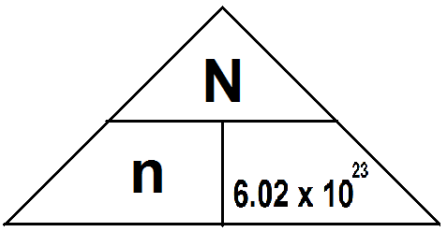
N is the number of particles ie. ions, atoms, molecules, formula units, electrons

Slide 29
Atoms
How many atoms are there in 1 mol of H₂O?
H₂O has 3 atoms
3 x 6.02 x 10²³ = 1.806 x 10²⁴ atoms
How many moles are in 12.04 x 10²³ atoms?
12.04 x 10²³ / 6.02 x 10²³ = 2 moles

Slide 30
Molecules
How many molecules are there in 4 moles of H₂0?
4 x 6.02 x 10²³ = 2.408 x 10²⁴ molecules
How many moles are there in 12.04 x 10²³ molecules of H₂O?
12.04 x 10²³ / 6.02 x 10²³ = 2 moles

Slide 31
Ions
How many H⁺ ions are there in 2.5 moles of HCl solution?
HCl completely dissociates to H⁺ in water
2.5 x 6.02 x 10²³ = 1.505 x 10²⁴ ions
How many moles are there in 14 x 10²³ H⁺ ions?
14 x 10²³ / 6.02 x 10²³ = 2.3 moles

Slide 32
Electrons
How many electrons are there in 1 mole of helium?
Helium contains 2 electrons
2 x 6.02 x 10²³ = 12.04 x 10²³ electrons
How many moles are there in 14 x 10³⁰ electrons?
14 x 10³⁰ / 6.02 x 10²³ = 2.3 x 10⁷ moles

Slide 33
Formula units
How many formula units are there in 1 mole of NaCl?
NaCl is a formula unit
1 x 6.02 x 10²³ = 6.02 x 10²³ formula units
How many moles are there in 1.0 x 10³⁰ formula units of NaCl?
1.0 x 10³⁰ / 6.02 x 10²³ = 1.7 x 10⁶ moles

Slide 34
Relative Masses
Relative Atomic Mass (A_{r})
The mass of an atom relative to the ¹²C isotope having a value of 12.000
A_{r} = average mass per atom of an element x 12
mass of one atom of carbon-12
Relative Isotopic Mass
Similar, but uses the mass of an isotope ²³⁸U
Relative Molecular Mass (M_{r})
Similar, but uses the mass of a molecule CO₂, N₂
Relative Formula Mass
Used for any formula of a species or ion NaCl, OH¯

Slide 35
What is the relative formula mass of NaCl?
A_{r}(Na) = 22.990 A_{r}(Cl) = 35.453
M_{r}(NaCl) = 22.990 + 35.453 = 58.443
What is the relative molecular mass of H₂O?
A_{r}(H) = 1.0079 A_{r}(O) = 15.999
M_{r}(H₂0) = 1.0079 x 2 + 15.999 = 18.015

Slide 36
Molar mass
Molar mass (M) (also atomic mass, formula mass) has the units g/mol, written as gmol⁻¹
By looking at the periodic table we see the atomic masses of the elements
eg. M(C) = 12.011gmol⁻¹

Slide 37
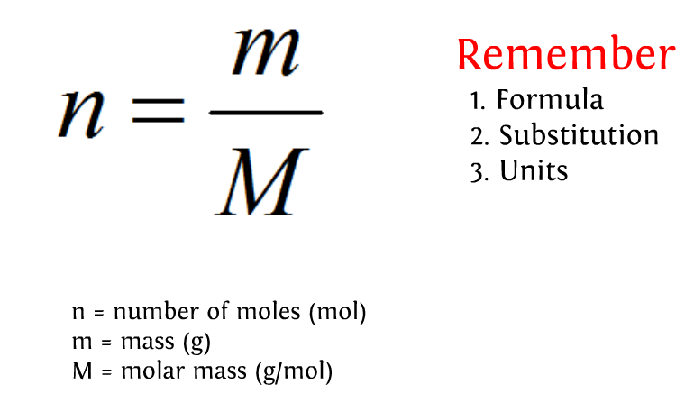
Moles

Slide 38
How many moles are there in 1.00g of NaCl?
M(NaCl) = 22.990 + 35.453 = 58.443g/mol
m(NaCl) = 1.00g
n(NaCl) = m/M = 1g/58.443g/mol
= 0.0171mol NaCl

Slide 39
How many grams are there in 2.00 moles of H₂O?
M(H₂0) = 1.0079 x 2 + 15.999 = 18.015g/mol
n=m/M so m=nM
m = 2.00 mol x 18.015g/mol = 36.0g H₂O

Slide 40
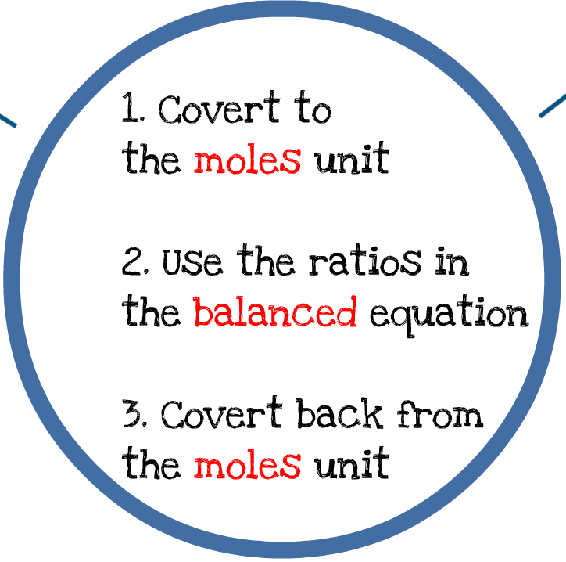
General strategy:

Slide 41
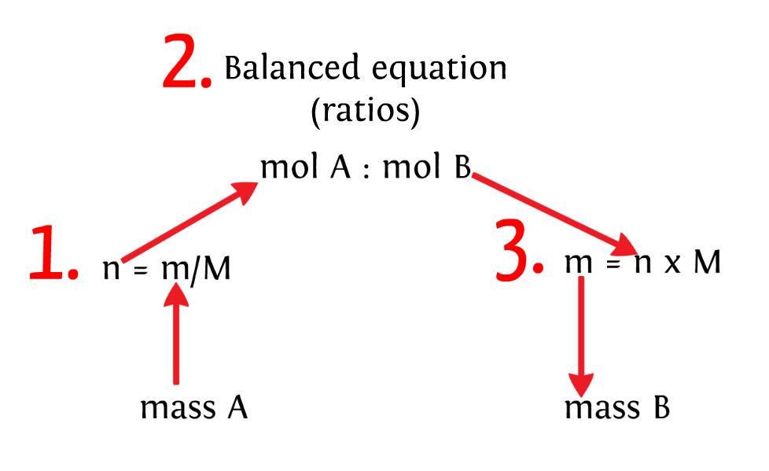
Solids strategy:

Slide 42
Problem 1:
184g of KClO₃ decomposes. How many grams of O₂ will be produced?
[K = 39, Cl = 35.5, O = 16]
2KClO₃ → 2KCl + 3O₂
n(KClO₃) = m/M = 184g/123g/mol = 1.50mol
2KClO₃ → 2KCl + 3O₂
2 : 3
1.50 : X
X = 2.25mol
m(O₂)= nM = 2.25 mol x 32.0 g/mol = 72.0g O₂

Slide 43
Problem 2:
How many grams of KClO₃ are needed to produce 205g of KCl?
2KClO₃ → 2KCl + 3O₂
n(KCl) = m/M = 205g/74.6g/mol = 2.75mol
KClO₃ : KCl
2 : 2
X : 2.75
X = 2.75mol KClO₃
m(KClO₃) = nM = 2.75mol X 122.55g/mol = 337g

Slide 44
Percentage composition
The amount of each element in a compound expressed as a percentage.
Problem: What is the percentage composition of S in sulfur dioxide?
M(SO₂) = 64g/mol
M(S) = 32g/mol
So the percentage mass is 32/64 x 100% = 50%
Fifty percent of the weight of SO₂ is S.

Slide 45
Empirical and molecular formulae
The empirical formula of a compound is defined as the simplest whole number ratio of atoms of different elements in the compound.
The molecular formula of a compound is the actual number of atoms of different elements covalently bonded in a molecule.
The two can be the same.
CH₂ empirical formula
C₂H₄ molecular formula
C₃H₆ molecular formula
H₂O both

Slide 47
Determining Empirical Formula
Pretend that you have a 100 gram sample of the compound (this is the trick to doing these problems).
That is, change the % to grams.
Convert the grams to moles for each element.
Write the number of moles as a subscript in a chemical formula.
Divide each number by the least number.
Multiply the result to get rid of any fractions.

Slide 48
Problem 1: Calculate the empirical formula of a compound composed of 38.67%C, 16.22%H, and 45.11%N.
Assume 100g so:
n(C) = 38.67g/12.01gmol⁻¹ = 3.220 mol C
n(H) = 16.22g/1.01gmol⁻¹ = 16.09 mol H
n(N) = 45.11g/14.01gmol⁻¹ = 3.219 mol N
3.220 mole C
16.09 mole H
3.219 mole N
C_{3.22}H_{16.09}N_{3.219}
If we divide all of these by the smallest one it will give us the empirical formula

Slide 49
3.220mol C = 1 mol C 3.219mol
16.09mol H = 5mol H
3.219mol
3.219mol N = 1 mol N
3.219mol
C₁H₅N₁
CH₅N is the empirical formula

Slide 50
Problem 2: A compound is 43.64 % P and 56.36 % O. What is the empirical formula?
n(P) = 43.6g/30.97gmol⁻¹ = 1.4 mol P
n(O) = 56.36g/16gmol⁻¹ = 3.5 mol O
Ratio = P_{1.4}O_{3.5}
Divide both sides by 1.4
P₁O_{2.5}
Multiply the result to get rid of any fractions.
2 X P₁O_{2.5} = P₂O₅

Slide 51
Determining Molecular Formula
Since the empirical formula is the lowest ratio the actual molecule would weigh more by a whole number multiple.
Divide the actual molar mass by the mass of one mole of the empirical formula.

Slide 52
Problem 1: Caffeine has a molar mass of 194 g/mol and its empirical formula is C₄H₅N₂O. What is its molecular formula?
Find x if
194 g
97 g
= 2
2 X
C₄H₅N₂O₁
C₈H₁₀N₄O₂

Slide 53
Problem 2:
A compound is known to be composed of 71.65 % Cl, 24.27% C and 4.07% H. Its molar mass is known (from gas density) is known to be 98.96 g. What is its molecular formula?
n(Cl) = 71.65g/35.5gmol⁻¹ = 2.0mol Cl
n(C) = 24.27g/12gmol⁻¹ = 2.0mol C
n(H) = 4.07g/1gmol⁻¹ = 4.0mol H
Cl₂C₂H₄ We divide by lowest (2mol ) Cl₁C₁H₂
This would give an empirical mass of 48.5g/mol, but its molar mass is 98.96 g.
So 2 X Cl₁C₁H₂ = Cl₂C₂H₄

Slide 54
1.3 Reacting masses and volumes
OBJECTIVES
• Reactants can be either limiting or excess.
• The experimental yield can be different from the theoretical yield.
• Avogadro’s law enables the mole ratio of reacting gases to be determined from volumes of the gases.
• The molar volume of an ideal gas is a constant at specified temperature and pressure.
• The molar concentration of a solution is determined by the amount of solute and the volume of solution.
• A standard solution is one of known concentration.
• Solution of problems relating to reacting quantities, limiting and excess reactants, theoretical, experimental and percentage yields.
• Calculation of reacting volumes of gases using Avogadro’s law.
• Solution of problems and analysis of graphs involving the relationship between temperature, pressure and volume for a fixed mass of an ideal gas.
• Solution of problems relating to the ideal gas equation.
• Explanation of the deviation of real gases from ideal behaviour at low temperature and high pressure.
• Obtaining and using experimental values to calculate the molar mass of a gas from the ideal gas equation.
• Solution of problems involving molar concentration, amount of solute and volume of solution.
• Use of the experimental method of titration to calculate the concentration of a solution by reference to a standard solution.

Slide 55
Theoretical and percentage yield
Actual Yield
x 100%
% Yield =
This determines the accuracy/efficiency of an experiment
% Error =
Theoretical Yield
Actual Yield – Theoretical Yield
x 100%
Theoretical Yield

Slide 56
How to do percentage yield problems
1. Write the balanced equation
2. List all knowns and unknowns
3. Convert to moles
4. Use mole ratios to determine unknowns
5. Convert to mass
6. Use the percentage yield formula

Slide 57
Problem: If 45.00g NH₃ came from 42.03gN₂ with excess H₂, what is the percentage yield?
N₂(g) + 3H₂(g) → 2NH₃(g)
1. Write the balanced equation N₂(g) + 3H₂(g) → 2NH₃(g)
2. List all knowns and unknowns
m(N₂) = 42.03g
M(N₂) = 28.02gmol⁻¹
m(NH₃) = ?
M(NH₃) = 17.04gmol⁻¹
3. Convert to moles
n(N₂) = m/M = 42.03g/28.02gmol⁻¹ = 1.500mol

Slide 58
4. Use mole ratios to determine unknowns
N₂(g) + 3H₂(g) → 2NH₃(g)
1 mol N₂ : 2 mol NH₃
1.500 mol N₂ : x mol NH₃
Therefore x = 2 x 1.500 = 3.000mol NH₃
5. Convert to mass
m(NH₃) = nM = 3.000g x 17.03gmol⁻¹ = 51.12g
6. Use the percentage yield formula
Percentage yield
= experimental yield/theoretical yield x 100%
= 45.00g/51.12g x 100%
= 88.03%

Slide 59
Limiting Reactant
We sometimes don’t always have perfect amounts of each reactant.
We can only make as much product as the limiting reactant will allow.
We must determine which reactant is limiting

Slide 60
Finding The Limiting Reactant
1) Balance the chemical equation
2) Find the number of mol’s of each reactant
3) Divide the # of moles by the coefficient found in the balanced eq^{n}
4) The chemical that has the smallest value is the limiting reactant.

Slide 61
Problem: 2.50x10³ kg of methane is mixed with 3.00x 10³kg of water.
1) Which reactant is the limiting one?
2) What is the mass of each product?
3) What is the mass of reactant left?
CH₄(g) + H₂O(g) → CO(g) + H₂(g)

Slide 62
1. n(H₂O)
= m/M = 3.00 x 10³kg/18gmol⁻¹
= 3.00 x 10⁶g/18gmol⁻¹
= 1.6667 x 10⁵mol
n(CH₄)
= m/M = 2.50 x 10³kg/16gmol⁻¹
= 2.50 x 10⁶g/16gmol⁻¹
= 1.563 x 10⁵mol
Therefore methane is the limiting reagent.

Slide 63
2. CH_{4(g)} + H₂O_{(g)} → CO_{(g)} + H_{2(g)}
n(CH₄) = 1.563 x 10⁵mol
1 mol CH₄ : 1 mol CO : 1 mol H₂
Therefore there is 1.563 x 10⁵mol of all compounds.
m(CO) = nM
= 1.563 x 10⁵mol x 18g/mol
= 2.81 x 10⁶g CO
m(H₂) = 1.563 x 10⁵mol x 2g/mol
= 3.13 x 10⁵g H₂

Slide 64
3. Left over n(H₂O)
= 1.6667 x 10⁵mol – 1.563 x 10⁵mol
= 0.1037 x 10⁵mol
m(H₂O) = nM
= 0.1037 x 10⁵mol x 18g/mol
= 1.867 x 10⁵g
Therefore 1.867 x 10⁵g of H₂O is remaining

Slide 65
Gases
Stoichiometry
Laws

Slide 66
Gas stoichiometry

Slide 67
Avogadro’s Law
“at the same temperature and pressure, equal volumes of different gases contain the same numbers of particles”
1 mole of gas = 22.7L
at STP
(0ºC = 273K, 100kPa)

Slide 68
Unit conversions
1L = 1dm³
1mL = 1cm³
So 1000cm³ = 1dm³

Slide 69
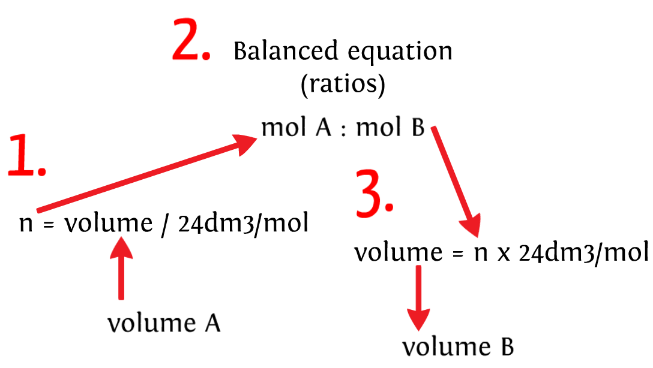
Gases strategy:
22.7dm³/mol
22.7dm³/mol

Slide 70
Problem: Quick lime CaO_{(s)} is produced by thermal decomposition of calcium carbonate. Calculate the volume of CO₂ gas produced at STP from the decomposition of 152g of calcium carbonate.
CaCO_{3(s)} → CaO_{(s)} + CO_{2(g)}
n(CaCO₃) = m/M = 152g / (40+12+(16x3)) g/mol
= 152/100 = 1.52mol
1 mol CaCO₃ : 1mol CO₂
Therefore 1.52 mol CO₂
V(CO₂) = n x 22.7dm³/mol
= 1.52mol x 22.7dm³/mol = 34.5dm³

Slide 71
Gas Laws

Slide 72
An ideal gas
1. The particles in a gas (atoms or molecules) are in random motion. The particles collide with one another as well as with the walls of the container.
*2. The volume occupied by the gas particles is negligible compared to the volume occupied by the gas. (The particles are assumed to behave like point masses.)
*3. The forces of attraction between the particles are negligible.
(i.e. the particles can move randomly and freely in all directions.)
4. All collisions between particles as well as with the walls of the container are perfectly elastic – that is, no energy is lost due to the collisions.
5. The average kinetic energy of the particles is directly proportional to the Kelvin temperature of the gas.

Slide 73
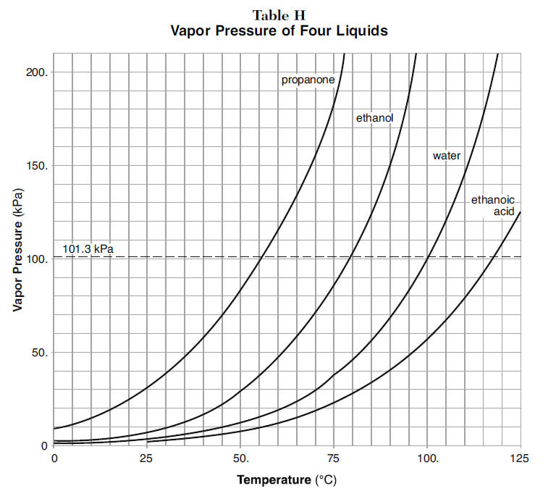
Alcohol rocket

Slide 74
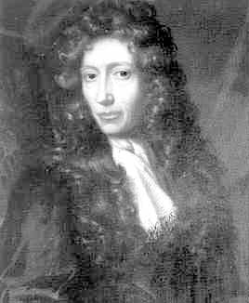
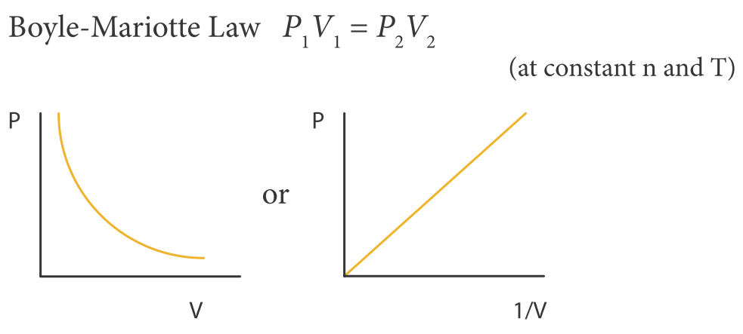
Boyle’s Law
The pressure exerted by a given mass of gas at constant temperature is inversely proportional to the volume occupied by the gas.
This is the only curved line. Make it straight by 1/V.

Slide 75
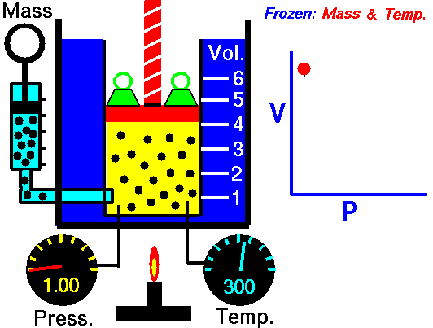

Slide 76
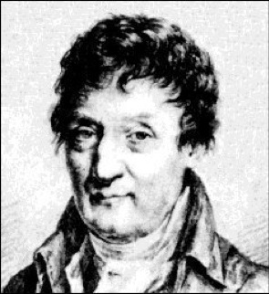
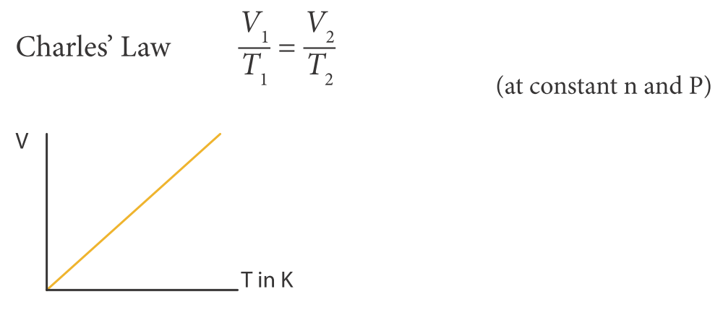
Charles’s Law
At constant mass and pressure, the volume is directly proportional to the temperature.

Slide 77
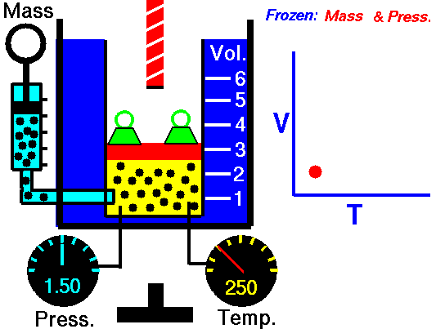

Slide 78
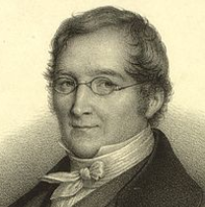
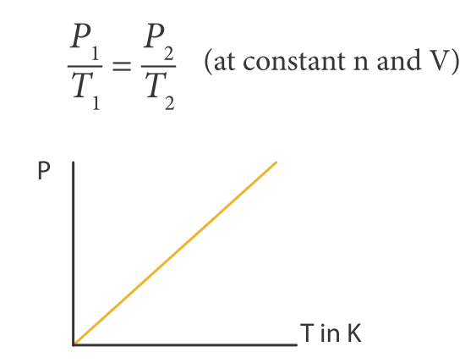
Gay-Lussacs Law
At constant mass and volume the pressure is directly related to temperature.

Slide 79
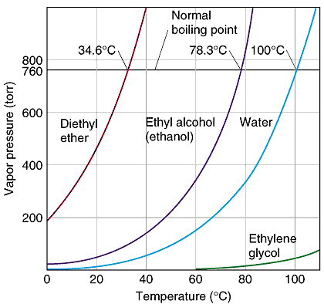
Exceptions to the rule:
At cold temperatures, gases particles can stick together.
Here the hydrogen bonding is being broken with temperature causing an exponential rise in pressure.

Slide 80
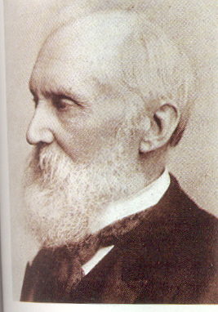
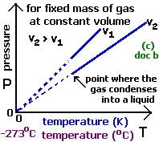
Lord Kelvin
Origin of the Kelvin scale

Slide 81
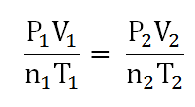
Ideal Gas Law
PV = nRT
P = pressure must be in Pa (N/m²) (1 atm = 101.3kPa = 760mmHg)
V = volume (m³) must divide by 1000 for dm³ to m³
n = number of moles
T = temperature (K) cannot be in Celcius (°C)
R = Universal Gas Constant = 8.314 JK⁻¹ mol⁻¹
If just using PV = nRT then units must be Pa, m³, K

Slide 82
Problem 1:
A deep sea diver is working at a depth where the pressure is 3.0 atmospheres. He is breathing out air bubbles. The volume of each air bubble is 2 cm³. At the surface the pressure is 1 atmosphere. What is the volume of each bubble when it reaches the surface?
What will happen to his blood if he goes to the surface?
P₁V₁ = P₂V₂
3atm x 2cm³ = 1atm x Xcm³
Therefore X = 6cm³
The volume of the bubble is 0.006dm³

Slide 83
Problem 2: A sample of hydrogen gas has a volume of 8.56L at a temperature of 0⁰C and a pressure of 1.5 atm. Calculate the moles of hydrogen gas present in this gas sample. R = 8.314 JK⁻¹ mol⁻¹
Gas law PV= nRT so must have correct units (Pa, m³, K):
P = 1.5atm = 1.5 x 101 kPa = 151 500Pa
V = 8.56dm³ = 8.56 x 1/1000 m³ = 8.56 x10⁻³ m³
T = 0⁰C = 0 + 273K = 273K
PV = nRT
151 500Pa x 8.56 x10⁻³ m³ = n x 8.314 JK⁻¹ mol⁻¹ x 273K
1297 = n 2270
n = 0.57 moles hydrogen

Slide 84
EXTRA: Dalton’s Law of Partial Pressures
As the type of gas does not affect the gas laws it follows then that each gas must act as a unit in causing gas pressure. The Law of Partial Pressure states that the total gas (vapour) pressure is equal to the partial pressures of each individual gas in the mixture:

Slide 85
Problem 1: A balloon contains 0.2 moles of nitrogen and 0.5 moles of oxygen. If the total pressure in the balloon is 2.0 atm, what is the partial pressure of oxygen?
P₁ = x₁ $×$ P = 0.5 / (0.2+0.5) x 2.0atm = 1.4atm

Slide 86
Liquids
Concentration
Titrations

Slide 87
Concentration

Slide 88
Key words
Solute – is something that dissolves eg. salt
Solvent – is something that does the dissolving eg. water
Solution – is a mixture of solutes and solvent eg. seawater
Concentration – is a measure of the amount of solute in solution eg. 1mol/dm³ NaCl
Notes:
88

Slide 89
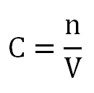
Solutions
Concentration = number of moles/volume
1cm³ = 1mL
1dm³ = 1L
1/dm³ = 1dm⁻³
Concentration is written as [ ].
eg. [H] = concentration of hydrogen

Slide 90
Concentration
Concentration can be written as:
mol/dm³
moldm⁻³
M

Slide 91
Parts per million (ppm)
Measured as 1 part per million solute.
Often calculated as 1 milligram in 1L or 1kg of substance such as water.

Slide 92
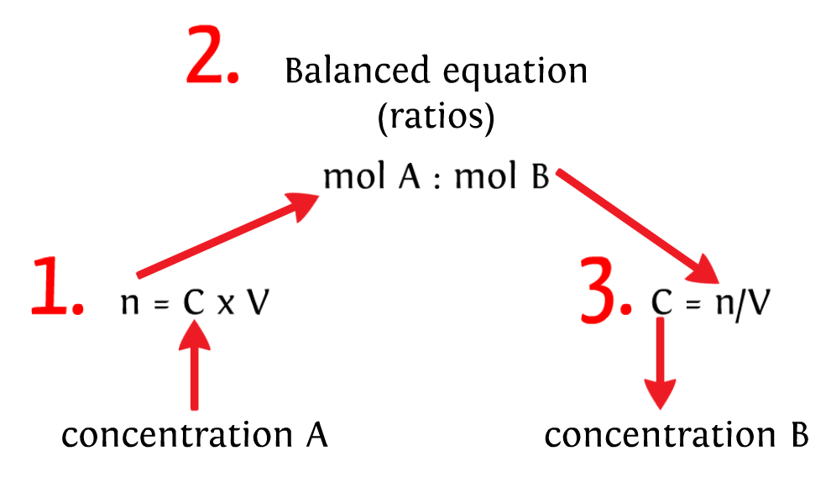
Liquids strategy:

Slide 93
Problem 1: A solution contains 2.65g of anhydrous Na₂CO₃ in 200cm³ of solution. Calculate the conc. of the solution [Na₂CO₃ = 106]
n(Na₂CO₃) = m/M = 2.65g/106g/mol = 0.025mol
[Na₂CO₃] = n/V = 0.025mol/0.200dm³
= 0.125moldm⁻³ or 0.125M
Notes:
93

Slide 94
Problem 2: What mass of sodium hydrogen carbonate NaHCO₃ would be required to prepare 100cm³ of 2.0 molar solution? [NaHCO₃ = 84]
[NaHCO₃] = n/V
$∴$ 2.0mol/dm³ = n/0.100dm³
n = 2.0 x 0.1 = 0.200mol
m(NaHCO₃) = nM = 0.200mol x 84g/mol = 16.8g
Notes:
94

Slide 95
Titrations

Slide 96
Key words
Titration is a method to determine the concentration of an unknown concentration using a known concentration called a standard solution or titrant.
Standard solution is solution of a precisely known concentration. Also called a primary standard. It is made with an analytical balance and a volumetric flask to over 99.99% accuracy. For IB no uncertainties are required.
Equivalence point or end point - the titration is stopped. To within one drop.
Indicator is a chemical that changes colour to signal the equivalence point.
Analyte is the chemical being measured and is also called the aliquot or titrate.
Notes:
96

Slide 97
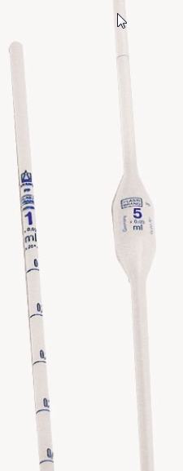
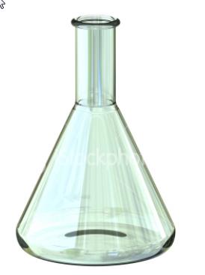
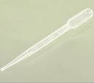
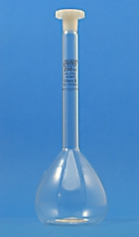
Apparatus
Conical flask
Pasteur pipette
Volumetric pipette
Burette
Volumetric flask
Notes:
97

Slide 98
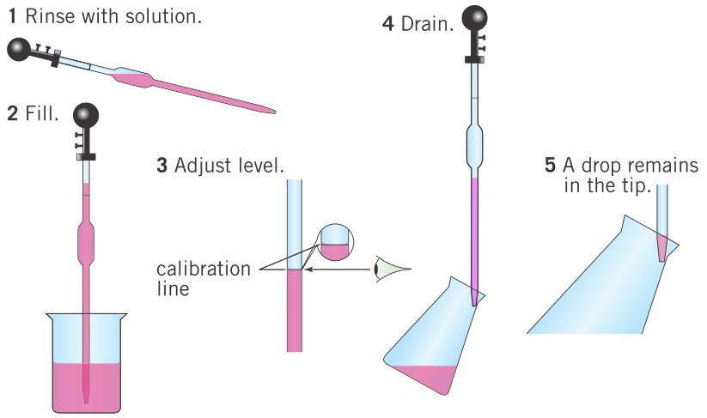
Using glassware – graduated or volumetric pipette

Slide 99
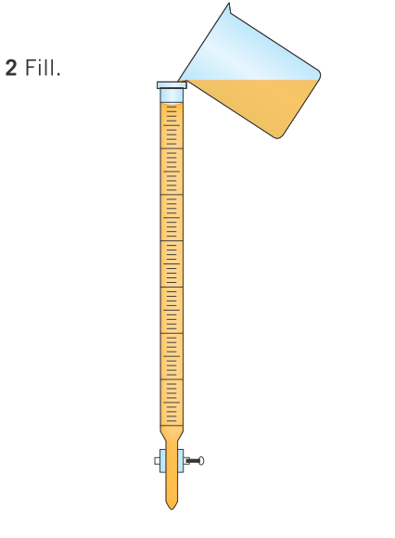
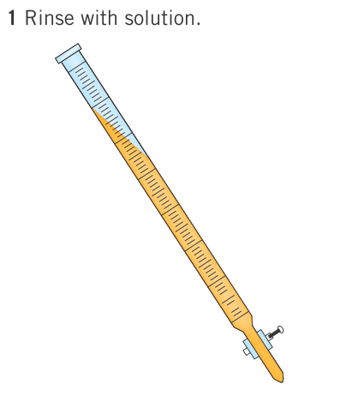
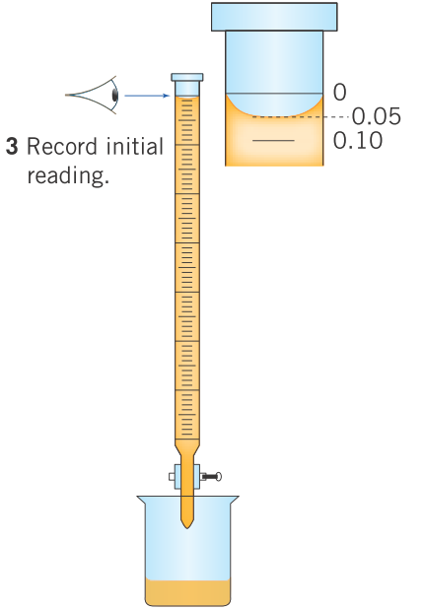
Using glassware – burette

Slide 100
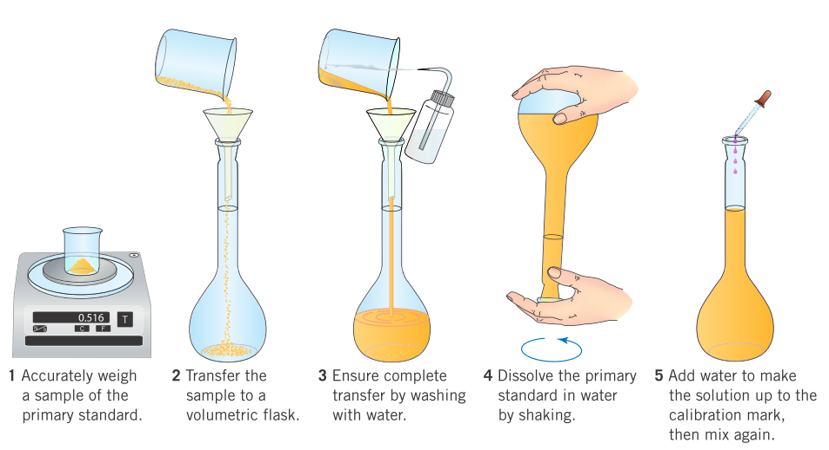
Using glassware – volumetric flask

Slide 101
Indicators
Titration between . . . | Indicator | Explanation
strong acid and strong base | any
strong acid and weak base | methyl orange | changes color in the acidic range (3.2 - 4.4)
weak acid and strong base | phenolphthalein | changes color in the basic range (8.2 - 10.6)
Weak acid and weak base | No suitable
Notes:
101

Slide 102
Dilutions
When a solution is diluted, more solvent is added to it, the number of moles of solute stays the same.
Make n the subject and substitute, it follows that
C₁V₁ = C₂V₂
where C₁=original concentration of solution
V₁=original volume of solution
C₂=new concentration of solution after dilution
V₂=new volume of solution after dilution
n₁ = no of mol of solute before dilution
n₂ = no of mole of solute after dilution
Notes:
102

Slide 103
Problem 1: Calculate the volume of a 12.0moldm⁻³ HCl solution that should be diluted with distilled water to obtain 1.0dm³ of a 0.05moldm⁻³ HCl.
C₁ = 12moldm⁻³, V₁ = ?
C₂ = 0.05moldm⁻³ , V₂ = 1.0dm³
C₁V₁ = C₂V₂
12moldm⁻³ x V₁ = 0.05moldm⁻³ x 1.0dm³
V₁ = 0.004dm³
$∴$4cm³ of 12M solution needs to be added to make up to 1L, to make a 0.05M final solution.
Notes:
103

Slide 104
Problem 2: 20cm³ of sulfuric acid titrate was neutralized with 25cm³ of 0.1moldm⁻³ sodium hydroxide standard solution. Calculate the concentration of the acid.
H₂SO₄ + 2NaOH → Na₂SO₄ + 2H₂O
n(NaOH) = CV = 0.1M x 0.025dm³ = 0.0025 mol NaOH
1 mol H₂SO₄ : 2 mol NaOH
X : 0.0025 mol
X = 0.00125 mol H₂SO₄
[H₂SO₄] = n/V = 0.00125 mol / 0.020dm³ = 0.0625moldm⁻³
Notes:
104

