Slide 1
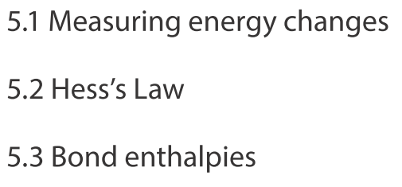
Topic 5 Energetics/thermochemistry
IB CHEMISTRY
Higher level

Slide 2
5.1 Measuring energy changes
OBJECTIVES
• Heat is a form of energy.
• Temperature is a measure of the average kinetic energy of the particles.
• Total energy is conserved in chemical reactions.
• Chemical reactions that involve transfer of heat between the system and the surroundings are described as endothermic or exothermic.
• The enthalpy change (∆H) for chemical reactions is indicated in kJ mol⁻¹.
• ∆H values are usually expressed under standard conditions, given by ∆H°, including standard states.
• Calculation of the heat change when the temperature of a pure substance is changed using q=mc∆T.
• A calorimetry experiment for an enthalpy of reaction should be covered and the results evaluated.

Slide 3
Temperature and Heat
Temperature is the average kinetic energy of molecules (K).
Heat is the amount of energy exchanged due to a temperature difference between two substances (J).

Slide 4
Enthalpy (H)
Enthalpy (H) – the amount of energy or heat content of a substance. The energy is stored in the chemical bonds. It includes kinetic and potential energy and is not measured directly but changes are measured (J).
Standard enthalpy change of reaction (ΔH⁰) - the difference between the enthalpy of the products and the enthalpy of the reactants at 298K and 1.00 x 10⁵Pa.

Slide 5
Enthalpy
Change in enthalpy (ΔH) – enthalpy of products less reactants. It is the heat energy change per mole.
ΔH = H_{P} – H_{R}
For exothermic reactions the temperature of the surroundings increases and ΔH is negative, energy is given out
For endothermic reactions the temperature of the surroundings decreases and ΔH is positive, energy is absorbed
The higher the enthalpy the less stable the substance

Slide 6
Enthalpy level diagrams

Slide 7
Enthalpy level diagrams
The energy is measured by temperature. We can calculate the energy change only. Not the energy stored in the resultant products or reactants.

Slide 8
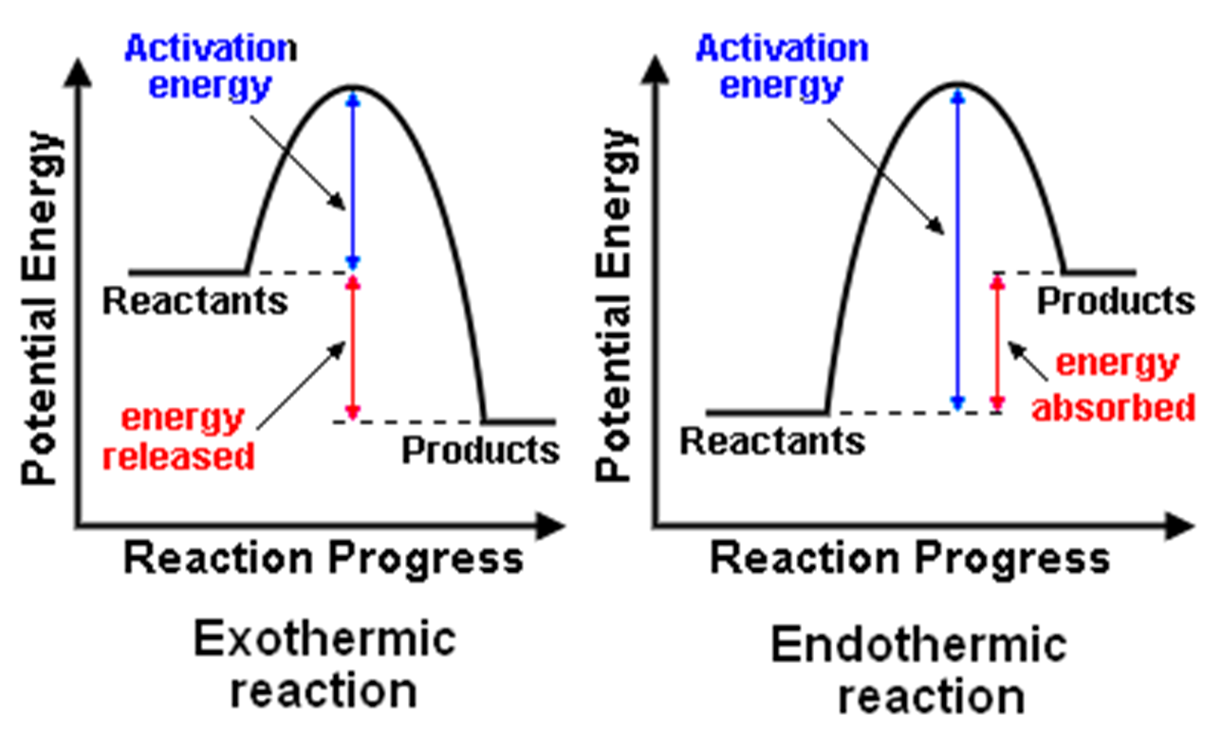

Slide 9
Exothermic reactions
Examples include:
Combustion reactions
Neutralization reactions
In an exothermic reaction products:
have less stored energy
are more stable
have stronger bonds (harder to break)

Slide 10
Heat energy change (Q)
Q = mcΔT
m = mass in g
c = specific heat capacity of the substance JK⁻¹g⁻¹
ΔT = change in temperature in K
Q = Heat energy change
ΔH = Heat energy change per mole
So, ΔH = Q /n

Slide 11
Calorimetry
A technique used to measure enthalpy change.
Heat absorbed, Q = (m x c x ΔT)_{liquid}
c _{water} = 4.18 JK⁻¹g⁻¹
m _{water} = volume in cm³ 1 cm³ = 1g

Slide 12
Styrofoam Calorimeter

Slide 13
Bomb Calorimeter

Slide 14
Assumptions and sources of error
That no heat is lost to or gained from the surroundings.
Significant errors are associated with reactions:
involving the evolution of gas
involving combustion where hot gas is used to heat liquid in a calorimeter.
Heat rises & ΔT under these conditions are reported to be less than the literature stipulates.
Thermometers often have precision uncertainty ± 0.1ºC or greater
Notes:
1. “All heat absorbed or evolved only changes the temperature of the calorimeter and its contents”. Misconception.

Slide 15
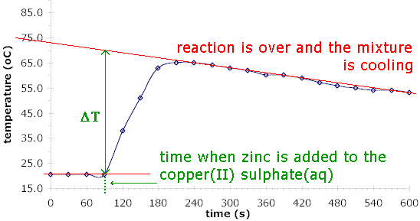
Measuring Enthalpy changes graphically
Temperature is constantly changing to return to room temperature so lines are extrapolated to calculate the value of ∆T.

Slide 16
Problem 1: 1200 kJ of heat is evolved when 2 moles of magnesium react completely with 1 mole of oxygen. How much energy is released if 0.600g of Mg is burnt?
2Mg(s) + O₂(g) → 2MgO(s)
So ΔH_{c}(Mg) = -1200kJmol⁻¹/2 = -600 kJmol⁻¹
n(Mg) = m/M = 0.600g/24.3g/mol = 0.0247mol
ΔH = Q/n
so Q = ΔH x n = -600 kJmol⁻¹ x 0.0247mol = 14.8 kJ

Slide 17
Problem 2: 20.0cm³ of 2M NaOH is added to 30.0cm³ HCl of the same concentration. The temperature increases by 12.0ºC. Determine the heat released.
Total volume is 50.0cm³, water density is 1.00 g cm⁻³ so mass of aqueous solution is 50.0g.
Amount of heat required to heat the water, Q
= mcΔT
= 50.0 g x 4.18Jg⁻¹ᵒC⁻¹ x 12.0ᵒC
= 2508 J or 2.51 kJ
Notes:
1. Dilute solution density assumed to be the same as for the water.

Slide 18
So, 2.51 kJ is the amount of heat energy evolved in the reaction:
HCl_{(aq)} + NaOH_{(aq)} → NaCl_{(aq)} + H₂O_{(l)}
So sodium hydroxide is the limiting reagent.
n(NaOH) = CV = 2M x 0.02dm³ = 0.0400 moles
(so the enthalpy PER MOLE can be determined)
ΔH(NaOH) = Q/n = 2.51kJ/0.04moles = 62.7 kJ/mol
The energy is evolved, exothermic, so
ΔH(NaOH) = -62.7 kJ/mol

Slide 19
Problem 3:
300 mL of 0.2 M aqueous KOH neutralizes 150 mL of aqueous 0.2 M H₂SO₄. We go from an average initial temperature of 22.3 ºC to a maximum of 29.2 ºC. Calculate the molar heat enthalpy of neutralisation of KOH and the molar heat of enthalpy of the reaction.
2KOH + H₂SO₄ → K₂SO₄ + 2H₂O
Q = mcΔT
= (300 + 150 g)(4.19)(29.2-22.3)
=13009.95 J
n(KOH) = CV = 0.2mol/L(0.300 L) = 0.06 mol
n(H₂SO₄) = CV = 0.2mol/L(0.150 L) = 0.03 mol
For molar enthalpy of neutralisation of KOH:
ΔH = Q/n = -13.10 kJ/0.06 moles = -217 kJ/mol of KOH
For molar enthalpy of the reaction you need to watch for stoichiometric ratios. There are 2 moles of KOH so divide by 2:
ΔH = Q/n = -13.10 kJ/0.03 moles = -109 kJ/mol
Notes:
1. Dilute solution density assumed to be the same as for the water.

Slide 20
5.2 Hess's Law
OBJECTIVES
• The enthalpy change for a reaction that is carried out in a series of steps is equal to the sum of the enthalpy changes for the individual steps.
• Application of Hess’s Law to calculate enthalpy changes.
• Calculation of ∆𝐻 reactions using ∆H_{f}° data.
• Determination of the enthalpy change of a reaction that is the sum of multiple reactions with known enthalpy changes.

Slide 21
Hess’s Law
In a chemical reaction the total change in chemical potential energy (enthalpy change) must be equal to the energy lost or gained by the reaction system.

Slide 22
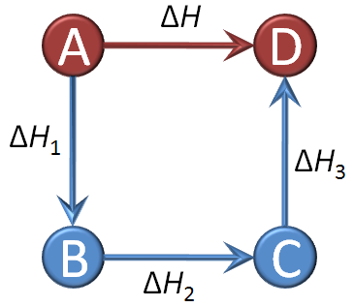
Enthalpy level cycles
Therefore according to Hess’s Law:
ΔH = ΔH₁ + ΔH₂ + ΔH₃

Slide 23
Problem 1:
C + ½O₂ → CO ΔH° = – 110.5 kJ
CO + ½O₂ → CO₂ ΔH° = – 283.0 kJ
C + CO + O₂ → CO + CO₂ ΔH° = – 393.5 kJ
C + O₂ → CO₂ ΔH° = – 393.5 kJ

Slide 24
Standard enthalpy change of formation (ΔH⁰_{f})
Standard enthalpy change of formation (ΔH⁰_{f}) – is the enthalpy change that results when one mole of a compound is formed from its elements at 298K and 1.00 x 10⁵Pa. All reactants and products are in their standard states.
Eg. C(s) + 2H₂(g) → CH₄(g)
6C(s) + 3H₂(g) + ½O₂(g) → C₆H₅OH(s)

Slide 25
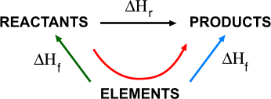
Using Hess’s Law to determine enthalpy of formation
ΔΗ_{f} = ΣΔΗ_{f} of products – ΣΔΗ_{f} of reactants

Slide 26
Problem 1:
Calcium carbonate reacts with hydrochloric acid according to the following equation:
CaCO₃ (s) + 2HCl (aq) → CaCl₂ (aq) + H₂O (l) + CO₂ (g)
Calculate the enthalpy change for this reaction
ΔHº_{reaction} = Σ ΔHº_{products} –ΣΔHº_{reactants}
Solution
ΔHº_{products} =(-796)+(-286)+(-394)
= -1476 kJ/mol
ΔHº_{reactants} =(-1207)+(2)(-167)
= -1541 kJ/mol
ΔHº_{reaction} = -1476-(-1541) = +75 kJ/mol
ΔHºCaCO₃ | -1207
ΔHº HCl (aq) | -167
ΔHºCaCl₂ | -796
ΔHº H₂O (l) | -286
ΔHº CO₂ (g) | -394

Slide 27
Problem 2:
Calculate the enthalpy change for the burning of 11 grams of propane
C₃H₈(g) + 5O₂(g) → 3CO₂(g) + 4H₂O(g)
ΔHº_{reaction} = Σ ΔHº_{products} –ΣΔHº_{reactants}
ΔHº C₃H₈ | -104
ΔHº O₂ (g) | 0
ΔHº H₂O (g) | -242
ΔHº CO₂ (g) | -394
Solution
ΔHº_{products} =(3)(-394)+(4)(-242)
= -2150 kJ/mol
ΔHº_{reactants} =(-104)+(5)(0)
= -104 kJ/mol
ΔHº_{reaction} = -2150-(-104) = -2046 kJmol⁻¹
Now 11 grams = 0.25 mole of propane (11 g/44 g mol⁻¹)
(0.25 mol )(-2046 kJ mol⁻¹) = 511.5 kJ

Slide 28
Standard Enthalpy of Combustion (∆H°_{c})
Standard enthalpy change of combustion (ΔH⁰_{C}) – is the enthalpy change that results when one mole of a compound reacts with oxygen at 298K and 1.00 x 10⁵Pa. All reactants and products are in their standard states.
Eg. C(graphite) + O₂(g) → CO₂(g)
H₂(g) + ½O₂(g) → H₂O(l)
C₂H₅OH(l) + 3O₂(g) → 2CO₂(g) + 3H₂O(l)

Slide 29
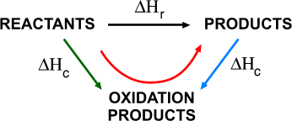
Using Hess’s Law to determine enthalpy of combustion
ΔΗ_{c} = ΣΔΗ_{c} of reactants – ΣΔΗ_{c} of products

Slide 30
Problem 1: Calculate the standard enthalpy of formation of methane; the standard enthalpies of combustion of carbon, hydrogen and methane are -394, -286 and -890 kJmol⁻¹ .
C(graphite) + 2H₂(g) → CH₄(g)
ΔΗ_{c} = ΣΔΗ_{c} of reactants – ΣΔΗ_{c} of products
= [ (1 x ΔΗ_{c} of C) + (2 x ΔΗ_{c} of H₂) ] - [ 1 x ΔΗ_{c} of CH₄]
= 1 x (-394) + 2 x (-286) - 1 x (-890)
= -76 kJmol⁻¹

Slide 31
SUMMARY
ΔHº_{reaction} = Σ ΔHº_{products} – ΣΔHº_{reactants}
ΔHº_{reaction} = ΔHº_{f products} – ΔHº_{f} _{reactants}
ΔHº_{reaction} = ΔHº_{c reactants} – ΔHº_{c products}
ΔHº_{reactant} = ΔHº_{reaction} / mole ratio

Slide 32
5.3 Bond enthalpies
OBJECTIVES
• Bond-forming releases energy and bond-breaking requires energy.
• Average bond enthalpy is the energy needed to break one mol of a bond in a gaseous molecule averaged over similar compounds.
• Calculation of the enthalpy changes from known bond enthalpy values and comparison of these to experimentally measured values.
• Sketching and evaluation of potential energy profiles in determining whether reactants or products are more stable and if the reaction is exothermic or endothermic.
• Discussion of the bond strength in ozone relative to oxygen in its importance to the atmosphere.

Slide 33
Bond enthalpy
Average bond enthalpy is the amount of energy required to break one mole of bonds in the gaseous state averaged across a range of compounds containing that bond.
Breaking bonds is endothermic
Making bonds in exothermic
If the overall reaction is exothermic, the bonds have lost energy, are more stable, and have higher bond enthalpies
If the overall reaction is endothermic, the bonds have gained energy, are less stable, and have lower bond enthalpies

Slide 34
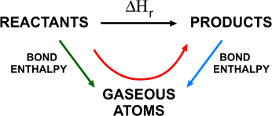
Using Hess’s Law and bond enthalpies to determine enthalpy of reaction
ΔΗ = Σ bond enthalpies – Σ bond enthalpies
of reactants of products

Slide 35
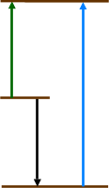
ATOMS
SUM OFTHE BOND ENTHALPIES OF THE REACTANTS
SUM OFTHE BOND ENTHALPIES OF THE PRODUCTS
REACTANTS
ΔΗ
PRODUCTS

Slide 36
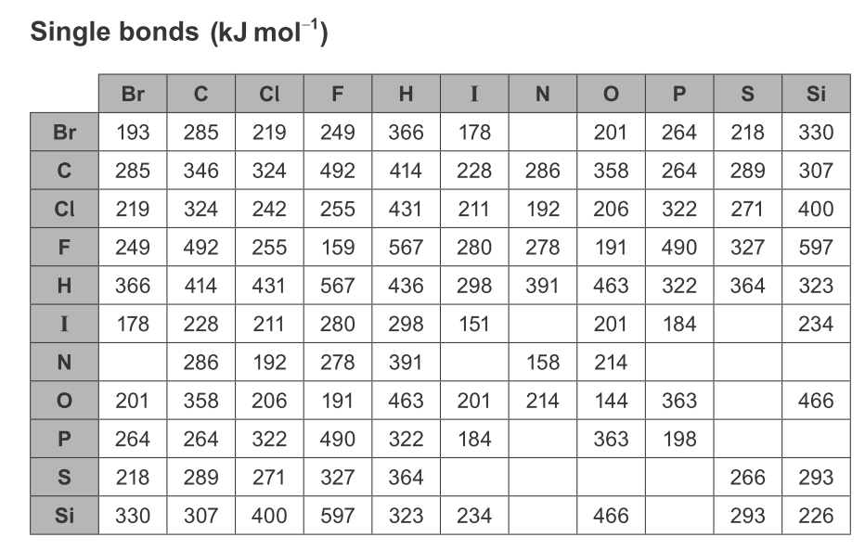
Bond Enthalpy Table
The average bond enthalpies are in your data booklet:

Slide 37
Problem 1: Calculate the enthalpy change for the reaction N₂ + 3H₂ → 2NH₃
Bonds broken
N⁼N: = 945
H-H: 3(435) = 1305
Total = 2250 kJ/mol
Bonds formed
2x3 = 6 N-H: 6 (390) = - 2340 kJ/mol
Net enthalpy change
ΔΗ = Σreactants – Σproducts
= + 2250 - 2340 = - 90 kJ/mol

Slide 38
Bond enthalpies of ozone
Ozone is decomposed more easily than oxygen.
O₂ requires 498kJ/mol to break
O₃ requires 364kJ/mol to break
O₂(g) → O•(g) + O•(g)
O₃(g) → O₂(g) + O•(g)

Slide 39
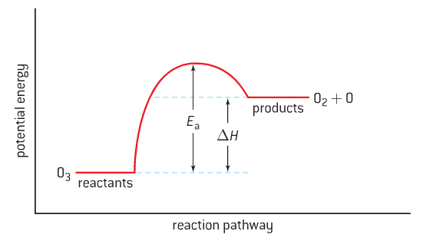
The energy profile shows that ozone molecule is more stable than the oxygen molecule with an oxygen radical

Slide 40
15.1 Energy cycles
Higher level
OBJECTIVES
• Representative equations (eg M⁺(g) → M⁺(aq)) can be used for enthalpy/energy of hydration, ionization, atomization, electron affinity, lattice, covalent bond and solution.
• Enthalpy of solution, hydration enthalpy and lattice enthalpy are related in an energy cycle.
• Construction of Born-Haber cycles for group 1 and 2 oxides and chlorides.
• Construction of energy cycles from hydration, lattice and solution enthalpy. For example dissolution of solid NaOH or NH₄Cl in water.
• Calculation of enthalpy changes from Born-Haber or dissolution energy cycles.
• Relate size and charge of ions to lattice and hydration enthalpies.
• Perform lab experiments which could include single replacement reactions in aqueous solutions.

Slide 41
KEY TERMS: Standard Enthalpy of formation ∆H°_{f}
Higher level
Standard enthalpy of formation ΔHº_{f} – for an ionic compound is the energy required to produce one mole of formula units from atoms in their natural state at 298K and 1.00 x 10⁵Pa.
M(s) + X → MX(s)
eg. Na(s) + ½Cl₂(g) → NaCl(s) ΔHº_{f} = -411kJ/mol

Slide 42
KEY TERMS: Enthalpy of atomization ∆H°_{at}
Higher level
Enthalpy of atomization ΔHº_{at} – is the energy change required to change one mole of atoms from their standard state to a gaseous state.
M(s) → M(g) ΔHº_{at} > 0
½X₂(g) → X(g) ΔHº_{at} > 0

Slide 43
KEY TERMS: Ionization energy ∆H°_{IE}
Higher level
Ionization energy ΔHº_{IE} – is the minimum energy required to remove of one mole of electrons from one mole of atoms or positive ions in the gaseous phase.
IE₁: M(g) → M⁺(g) + e⁻ Δ$H_{{IE}_{1}}^{°}$ > 0
IE₂: M⁺(g) → M²⁺(g) + e⁻ Δ$H_{{IE}_{2}}^{°}$ > 0

Slide 44
KEY TERMS: Electron affinity ∆H°_{EA}
Higher level
Electron affinity ΔHº_{EA} – is the energy change that occurs when one mole of electrons joins to one mole of atoms in the gaseous phase.
X(g) + e⁻ → X⁻(g) ΔHº_{EA} < 0

Slide 45
KEY TERMS: Lattice enthalpy ∆H°_{lat}
Higher level
Lattice enthalpy ΔHº_{lat} – The energy required to convert one mole of the solid compound into gaseous ions.
MX(s) → M⁺(g) + X⁻ (g) ΔHº_{lat} > 0
Eg. NaCl_{(s)} → Na⁺_{(g)} + Cl⁻_{(g)} ΔHº_{lat} = +771 kJ/mol

Slide 46
Magnitude of lattice enthalpy
Higher level
Depends on:
Size of the charge on the ions
Greater the charge the greater the attraction thus larger the lattice energy
Size of the ions
Larger the ions the further apart they are and the more separate the charges the smaller the lattice energy

Slide 47
Magnitude of lattice enthalpy
Higher level
Cl¯ Br¯ F¯ O²⁻
Na⁺ -780 -742 -918 -2478
K⁺ -711 -679 -817 -2232
Rb⁺ -685 -656 -783
Mg²⁺ -2256 -3791
Ca²⁺ -2259
Units: kJ mol⁻¹
Smaller ions will have a greater attraction for each other because of their higher charge density. They will have larger lattice enthalpies and larger melting points because of the extra energy which must be put in to separate the oppositely charged ions.

Slide 48
Magnitude of lattice enthalpy
Higher level
Na⁺
Cl¯
K⁺
Cl¯
The sodium ion has the same charge as a potassium ion but is smaller. It has a higher charge density so will have a more effective attraction for the chloride ion. More energy will be released when they come together.

Slide 49
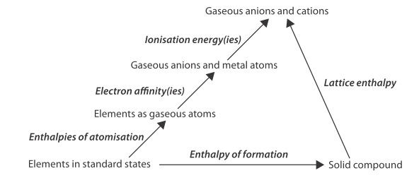
Born-Haber cycle
Higher level
The Born-Haber cycle is a diagrammatic representation of the formation of ionic compounds, starting from atoms, moving to gaseous atoms to gaseous ions to a solid compound. We use it to determine lattice enthalpy.

Slide 50
Higher level
kJmol⁻¹
Born-Haber Cycle for Sodium Chloride
+800
+700
1 Atomization of Sodium
+600
+500
+400
+300
+200
Na(g) + 1/2 Cl₂(g)
+100
Θ
at
0
Na(s) + 1/2 Cl₂(g)
H = +107kJmol⁻¹
-100
-200
-300
-400

Slide 51
Higher level
kJmol⁻¹
Born-Haber Cycle for Sodium Chloride
+800
+700
+600
+500
2 Atomization of Chlorine
+400
+300
Na(g) + Cl(g)
+200
½
θ
at
H = +121kJmol⁻¹
Na(g) + 1/2 Cl₂(g)
+100
0
Na(s) + 1/2 Cl₂(g)
-100
-200
-300
-400

Slide 52
Higher level
kJmol⁻¹
Born-Haber Cycle for Sodium Chloride
+800
Na⁺(g) + Cl(g)
+700
+600
e⁻
3 First Ionisation of Sodium
+500
θ
IE
+400
H = +502kJmol⁻¹
+300
Na(g) + Cl(g)
+200
+
Na(g) + 1/2 Cl₂(g)
+100
0
Na(s) + 1/2 Cl₂(g)
-100
-200
-300
-400

Slide 53
Higher level
kJmol⁻¹
Born-Haber Cycle for Sodium Chloride
+800
+800
+800
Na⁺(g) + Cl(g)
+700
+700
+700
4 Electron Affinity of Chlorine
+600
+600
+600
θ
EA
+500
H = -355kJmol⁻¹
+500
+500
e⁻
+400
+400
+400
Na⁺(g) + Cl⁻(g)
+300
+300
+300
Na(g) + Cl(g)
Na(g) + Cl(g)
Na(g) + Cl(g)
+200
+200
+200
Na(g) + 1/2 Cl₂(g)
Na(g) + 1/2 Cl₂(g)
Na(g) + 1/2 Cl₂(g)
e⁻
+100
+100
+100
Na(s) + 1/2 Cl₂(g)
Na(s) + 1/2 Cl₂(g)
0
Na(s) + 1/2 Cl₂(g)
0
0
-100
-100
-100
-200
-200
-200
-300
-300
-300
-400
-400
-400

Slide 54
Higher level
kJmol⁻¹
Born-Haber Cycle for Sodium Chloride
+800
+800
+800
Na⁺(g) + Cl(g)
+700
+700
+700
+600
+600
+600
+500
+500
+500
+400
+400
+400
+300
Na⁺(g) + Cl⁻(g)
+300
+300
Na(g) + Cl(g)
Na(g) + Cl(g)
Na(g) + Cl(g)
-
+
-
+200
+200
+200
Na(g) + 1/2 Cl₂(g)
Na(g) + 1/2 Cl₂(g)
Na(g) + 1/2 Cl₂(g)
-
+100
+100
+100
+
+
Na(s) + 1/2 Cl₂(g)
Na(s) + 1/2 Cl₂(g)
0
Na(s) + 1/2 Cl₂(g)
0
0
-
-
+
-100
-100
-100
-200
θ
f
-200
-200
H = -411kJmol⁻¹
-300
-300
-300
5 Formation of Sodium Chloride
-400
-400
-400
NaCl(s)

Slide 55
Higher level
kJmol⁻¹
Born-Haber Cycle for Sodium Chloride
+800
+800
+800
Na⁺(g) + Cl(g)
+700
+700
+700
+600
-
+600
+600
+
+500
+500
+500
+400
+400
+400
+300
Na⁺(g) + Cl⁻(g)
+300
+300
Na(g) + Cl(g)
Na(g) + Cl(g)
Na(g) + Cl(g)
Lattice Enthalpy for Sodium Chloride
+200
+200
+200
Na(g) + 1/2 Cl₂(g)
Na(g) + 1/2 Cl₂(g)
Na(g) + 1/2 Cl₂(g)
+100
+100
+100
Na(s) + 1/2 Cl₂(g)
Na(s) + 1/2 Cl₂(g)
0
Na(s) + 1/2 Cl₂(g)
0
0
-
+
-
-
-100
-100
-100
θ
lat
+
-
+
H = 786 kJmol⁻¹
-200
-200
-200
-
+
-
-300
-300
-300
+
-400
-400
-400
NaCl(s)

Slide 56
Applying Hess’s Law to Born-Haber cycles
Higher level
ΔH_{atm}Na + ΔH_{atm}Cl + ΔH_{IE} + ΔH_{EA} - ΔH_{lat} = ΔH_{f}
Rearrange to find the lattice energy:
- ΔH_{lat} = ΔH_{f} - (ΔH_{atm}Na + ΔH_{atm}Cl + ΔH_{IE} + ΔH_{EA})

Slide 57
Difference between experimental and theoretical lattice enthalpies
Higher level
Covalent character increases down a group and across a period
Covalent character increase as the difference between experimental and theoretical values of lattice enthalpy increases.

Slide 58
Solvation
Higher level
Solvation is when intermolecular forces form between a solvent and solute.
The type of ion formed affects the strength of the bond.

Slide 59
KEY TERMS: Enthalpy of solution ∆H°_{sol}
Higher level
Enthalpy of solution ΔHº_{sol} – is the energy change that occurs when one mole of substance dissolves in excess solvent. The value may be positive or negative.
MX(s) → M⁺(aq) + X⁻(aq)

Slide 60
KEY TERMS: Enthalpy of hydration ∆H°_{hyd}
Higher level
Enthalpy of hydration ΔHº_{hyd} – is the energy change that occurs when one mole of gaseous ions are added to water to form a dilute solution.
The value is always negative. If another solvent other than water is used it is enthalpy of solvation.
M⁺(g) → M⁺(aq)
X⁻(g) → X⁻(aq)

Slide 61
Higher level
Problem 1: Calculate the enthalpy of solution for sodium hydroxide using your data booklet and given the lattice enthalpy for NaOH is 900kJ/mol.
Na⁺(g) + OH⁻(g) ΔHº_{lat} = +900kJ/mol
ΔHº_{hyd}= -424 + - 519 kJ/mol (data booklet)
Na⁺(aq) + OH⁻(aq)
ΔHº_{sol} = ?
NaOH(s)
ΔHº_{sol}
= ΔHº_{lat}(NaOH) + ΔHº_{hyd}(Na⁺) + ΔHº_{hyd}(OH⁻)
= 900 + -424 + -519 kJ/mol
= - 43 kJ/mol

Slide 62
15.2 Entropy and spontaneity
Higher level
OBJECTIVES
• Entropy (S) refers to the distribution of available energy among the particles. The more ways the energy can be distributed the higher the entropy.
• Gibbs free energy (G) relates the energy that can be obtained from a chemical reaction to the change in enthalpy (ΔH), change in entropy (ΔS), and absolute temperature (T).
• Entropy of gas>liquid>solid under same conditions.
• Prediction of whether a change will result in an increase or decrease in entropy by considering the states of the reactants and products.
• Calculation of entropy changes (ΔS) from given standard entropy values (S°).
• Application of ΔG° = ΔH° - TΔS° in predicting spontaneity and calculation of various conditions of enthalpy and temperature that will affect this.
• Relation of ΔG to position of equilibrium.

Slide 63
Higher level
Is this your room?
Then you already know about entropy

Slide 64
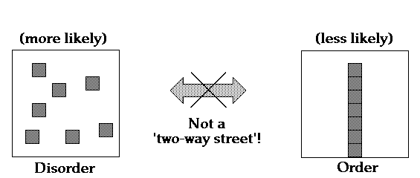
Entropy (S)
Higher level
Entropy (S) is the measure of the distribution of total available energy between the particles. The greater the disorder of the particles, the greater the entropy.

Slide 65
Higher level
A system (such as a room) is in a state of high entropy when its degree of disorder is high.
For better or for worse, nature 'likes' chaos, disorder, high entropy... In fact, much of our life consists in fighting this disorder!

Slide 66
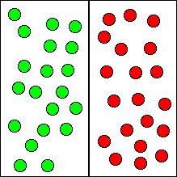
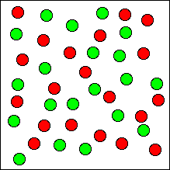
Higher level
2²⁰ ways to arrange?
This can be explained in terms of probabilities. Disordered states are simply more likely to exist (or emerge) than ordered states. The spontaneous direction of change is from a less probable to a more probable state, as illustrated above.

Slide 67
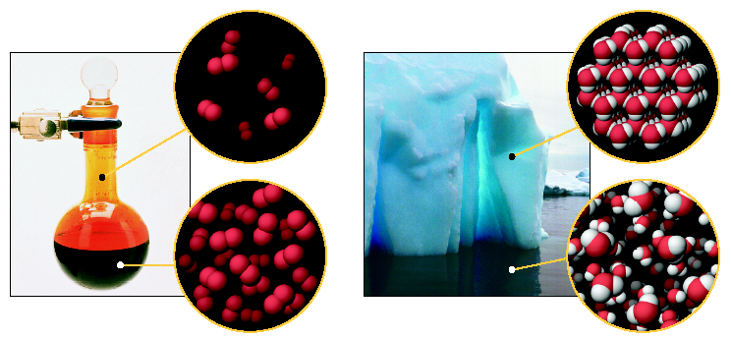
Entropy and States of Matter
Higher level
S˚(Br₂ liquid) < S˚(Br₂ gas)
S˚(H₂O solid) < S˚(H₂O liquid)

Slide 68
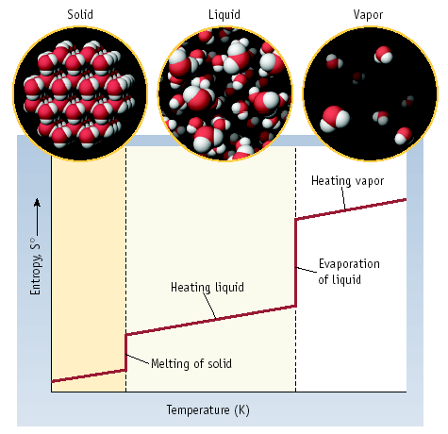
Entropy, Phase & Temperature
Higher level
S increases slightly with T
S increases a large amount with phase changes

Slide 69
Entropy and Temperature
Higher level
The Entropy of a substance increases with temperature.
Molecular motions of heptane, C₇H₁₆
Molecular motions of heptane at different temps.

Slide 70
Predicting entropy changes
Higher level
The change in the number of gaseous particles is usually the largest factor to be considered, even if a comparable reaction has a greater increase in total particles but these particles are still in the liquid or solid state.

Slide 71
Entropy calculations
Higher level
Units J K⁻¹ mol⁻¹.
An increase in disorder produces a +ve ΔS:
1. Decomposition reactions
2. Changes in state
3. Dissolution reactions
4. Increases in temperature

Slide 72
Standard entropy calculations
Higher level
aA + bB → cC +dD
Standard entropy change of reaction ΔS⁰_{rxn}:
ΔS⁰ = ∑ ΔS⁰ (products) - ∑ ΔS⁰ (reactants)
= [c ΔS⁰ (C) + d ΔS⁰ (D)] - [a ΔS⁰ (A) + b ΔS⁰ (B)]

Slide 73
Higher level
Problem 1: Calculate the standard entropy change for the following reaction:
H₂(g) + ½O₂(g) → H₂O(l)
ΔS⁰(H₂) = 130.7J/Kmol
ΔS⁰(O₂) = 205.1J/Kmol
ΔS⁰ = ∑ ΔS⁰ (products) - ∑ ΔS⁰ (reactants)
= ΔS⁰(H₂O) – [½ΔS⁰(O₂) + ΔS⁰(H₂)]
= 70 – (130.7 + ½ x 205.1)
= -163.3J/K

Slide 74
Gibbs free energy
Higher level
Gibbs free energy (G) is the energy available to do work.
ΔGﾟ=ΔHﾟ- TΔSﾟ (Temp. in K)
If ΔG is negative the reaction will be spontaneous
If ΔG is positive the reaction will not be spontaneous.
For any element in its standard state ΔGﾟ= 0.

Slide 75
Gibbs free energy useful equations for calculations
Higher level

Slide 76
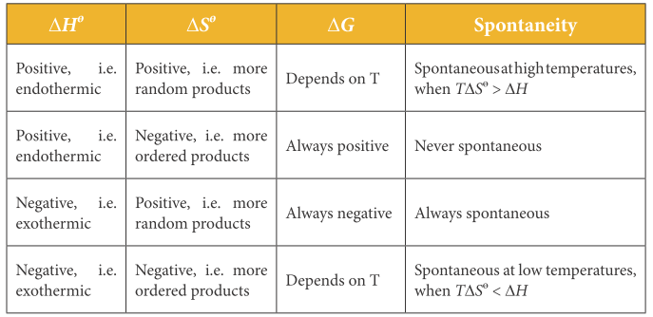
Spontaneity
Higher level

Slide 77
Summary of natural trends
Higher level
ΔHﾟ | Enthalpy | Energy | -ve
ΔSﾟ | Entropy | Randomness | +ve
ΔGﾟ | Free Energy | Spontaneity | -ve

Slide 78
Higher level
Problem 1: Calculate Gibbs free energy change of reaction for the combustion of ethanol (C₂H₅OH).
C₂H₅OH(l) 3O₂(g) → 2CO₂(g) + 3H₂O(g)
ΔG⁰(O₂) = 0 as in its standard state
ΔG⁰ = ∑ ΔG⁰ (products) - ∑ ΔG⁰ (reactants)
= [2ΔG⁰(CO₂) + 3ΔG⁰(H₂O) ] – [ΔG⁰(C₂H₅OH)]
= [2 x -394.4 + 3 x -228.6] – [-175]
= -1299.6kJ/mol

Slide 79
Higher level
Problem 2: Determine if the following reaction will be spontaneous at 298K.
C₂H₆(g) → C₂H₄(g) + H₂(g)
ΔH⁰ = 137kJ
ΔS⁰ = 120J/K
ΔG⁰ = ΔH⁰ - TΔS⁰
= 137 – (298 x 120/1000)
= 101kJ
As this value is positive, the reaction will not be spontaneous at 298K.

Slide 80
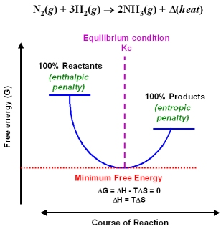
Gibbs free energy and equilibrium
Higher level
The point at which Gibbs free energy is at a minimum determines if a reaction goes to completion or reaches a balance of reactants and products (equilibrium).

