Slide 1
Topic 6 Chemical kinetics
IB CHEMISTRY
Higher level

Slide 2
6.1 Collision theory and rates of reaction
OBJECTIVES
• Species react as a result of collisions of sufficient energy and proper orientation.
• The rate of reaction is expressed as the change in concentration of a particular reactant/product per unit time.
• Concentration changes in a reaction can be followed indirectly by monitoring changes in mass, volume and colour.
• Activation energy (E_{a}) is the minimum energy that colliding molecules need in order to have successful collisions leading to a reaction.
• By decreasing E_{a}, a catalyst increases the rate of a chemical reaction, without itself being permanently chemically changed.
• Description of the kinetic theory in terms of the movement of particles whose average kinetic energy is proportional to temperature in Kelvin.
• Analysis of graphical and numerical data from rate experiments.
• Explanation of the effects of temperature, pressure/concentration and particle size on rate of reaction.
• Construction of Maxwell–Boltzmann energy distribution curves to account for the probability of successful collisions and factors affecting these, including the effect of a catalyst.
• Investigation of rates of reaction experimentally and evaluation of the results.
• Sketching and explanation of energy profiles with and without catalysts.

Slide 3
Collision (kinetic) theory
Particles must collide.
Particles must have enough kinetic energy to overcome electron cloud repulsion to react. This is called activation energy (E_{a}) and is directly proportional to the temperature in Kelvin.
Particles must collide in the correct geometrical alignment (steric factor).

Slide 4
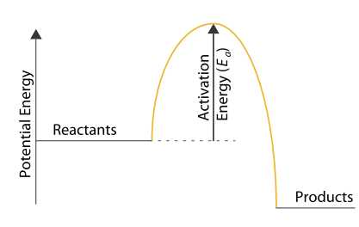
Activation energy

Slide 5
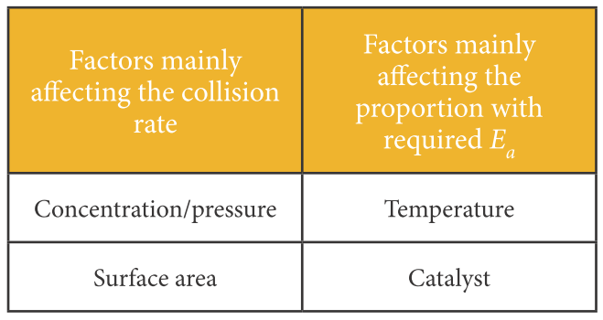
Collision rate vs Activation energy

Slide 6
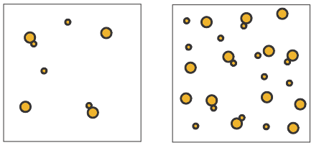
1. Concentration - Collision theory
Increasing the concentration increases the rate at which particles collide.

Slide 7
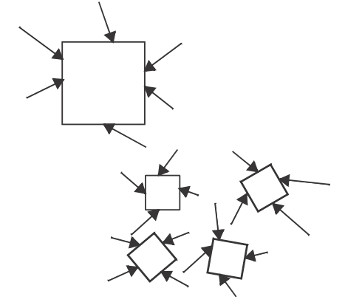
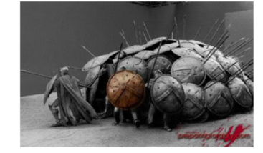
2. Surface area - Collision theory
Increasing the surface area increases the area for particles to contact therefore increases collisions.

Slide 8
3. Temperature - Collision theory
Increasing the temperature increases to some degree the collision rate but more importantly it increases the number of particles that will have sufficient activation energy to react (E>E_{a}).

Slide 9
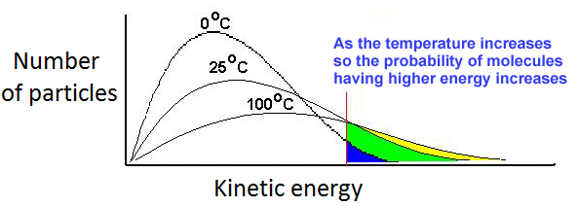
Temperature - Maxwell-Boltzmann curve

Slide 10
4. Catalysts - Collision theory
Catalysts decrease the activation energy therefore increases the number of particles that have sufficient energy to overcome the activation energy.

Slide 11
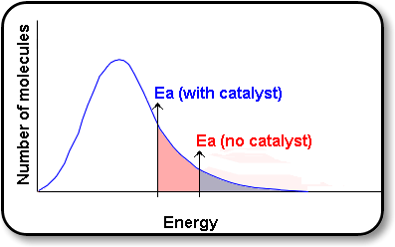
Catalysts - Maxwell-Boltzmann curve

Slide 12
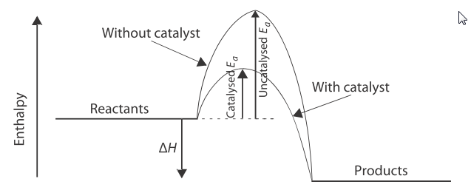
Catalysts – Enthalpy level diagram

Slide 13
Rate of reaction
Rate of reaction is the change of concentration of reactants or products with time (mol dm⁻³ s⁻¹)
Rate = - Δ[R] = Δ[P]
Δt Δt

Slide 14
Rate Factors
If not the independent variable, then these are key controlled variables
What factors will determine rate?
Surface area (usually refers to solid)
Concentration or pressure (if gas)
Temperature
Catalyst
How is it found?
Through experimentation only
Rate of decreasing reactants
−Δ[Concentration]/ Δ[time]
Rate of increasing products
Δ[Concentration]/ Δ[time]
Notice the negative sign

Slide 15
What to measure
Changes in
gas or pressure
mass
colour
pH
conductivity
You should be thinking about these for a Design lab

Slide 16
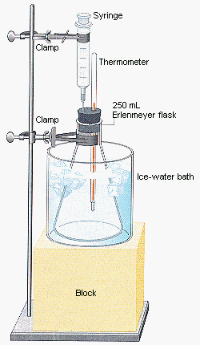
Gas collection - syringe
This set up is good for hydrogen as it is lighter than air
How have they controlled their variables?

Slide 17
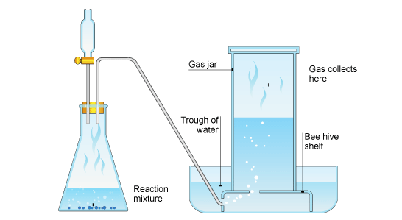
Gas collection – over water
Not good for water soluble chemicals
Warmer water will decrease solubility

Slide 18
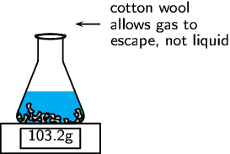
Change in mass
Not good for light gases such as hydrogen

Slide 19
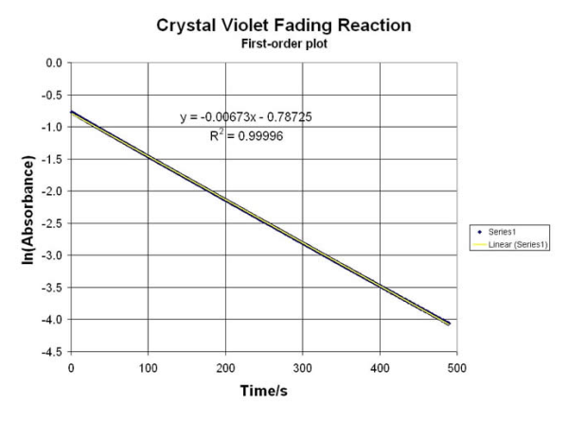
Change in colour
Colorimetry/spectrophotometry
Absorbance and transmittance
Measures concentration

Slide 20
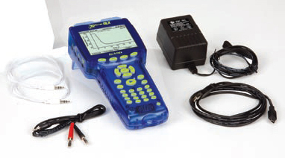
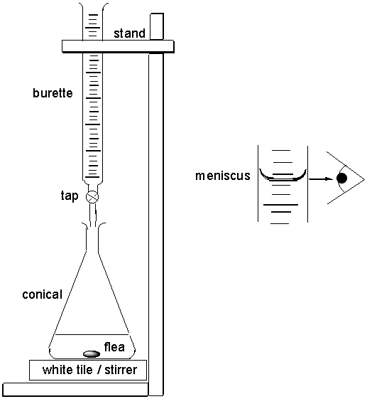
Change in pH or conductivity
Data loggers and probes
Conductivity
Acid/base
Titrations
Acid/ base
Concentration

Slide 21
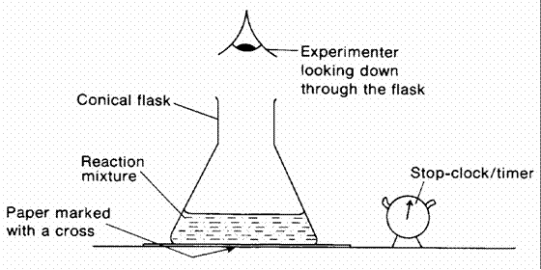
Change to a point - Clock reactions
Measuring to a certain point in a reaction
Eg. Magnesium strip disappears, or a certain precipitate clouds solution (picture opposite)

Slide 22
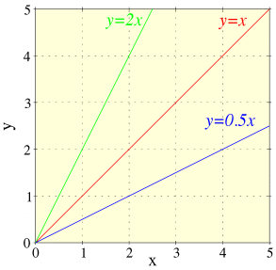
Math revision y=x
Slope = Δy/Δx

Slide 23
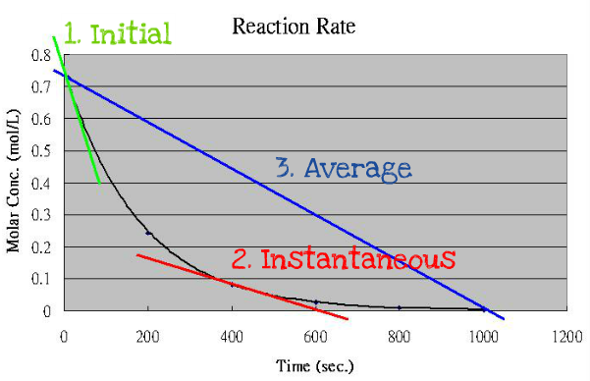
Graphical Interpretation
Due to the uncontrolled effects of temperature and concentration changes, initial rate of reaction is preferred.

Slide 24
16.1 Rate expression and reaction mechanism
Higher level
OBJECTIVES
• Reactions may occur by more than one step and the slowest step determines the rate of reaction (rate determining step/RDS).
• The molecularity of an elementary step is the number of reactant particles taking part in that step.
• The order of a reaction can be either integer or fractional in nature. The order of a reaction can describe, with respect to a reactant, the number of particles taking part in the rate-determining step.
• Rate equations can only be determined experimentally.
• The value of the rate constant (k) is affected by temperature and its units are determined from the overall order of the reaction.
• Catalysts alter a reaction mechanism, introducing a step with lower activation energy.
• Deduction of the rate expression for an equation from experimental data and solving problems involving the rate expression.
• Sketching, identifying, and analysing graphical representations for zero, first and second order reactions.
• Evaluation of proposed reaction mechanisms to be consistent with kinetic and stoichiometric data.

Slide 25
Math revision - powers
x⁻¹ = 1/x

Slide 26
The Rate Equation
Higher level
links the rate of reaction to the concentration of reactants
it can only be found by doing actual experiments
it cannot be found by just looking at the equation
Chemical equation: A + B → C + D
Possible rate equation: r = k[A][B]²
If [A] is doubled, then the rate doubles, if [B] doubles then the rate quadruples (2²).
r = rate of reaction (mol.dm⁻³s⁻¹)
k = rate constant (units depend on the rate equation)
Catalysts speed up reactions so also need to be included in the rate equations.

Slide 27
Order of reaction
Higher level
Individual order The power to which a concentration is raised in the rate equation
Overall order The sum of all the individual orders in the rate equation.
e.g. in the rate equation r = k[A][B]²
the order with respect to A is 1 1st Order
the order with respect to B is 2 2nd Order
the overall order is 3 3rd Order
The value is zero if the rate is unaffected by how much of a substance is present.

Slide 28
Units for the Rate Constant (k)
Higher level
The units of k depend on the overall order of reaction.
Divide the rate by as many concentrations (mol dm⁻³) as appear in the rate equation.
r = k[A] k will have units of sec⁻¹
r = k[A]² k will have units of dm³ mol⁻¹ sec⁻¹
r = k[A][B]² k will have units of dm⁶ mol⁻² sec⁻¹
Overall Order | 0 | 1 | 2 | 3
Units of k | mol dm⁻³ sec⁻¹ | sec⁻¹ | mol⁻¹ dm³ sec⁻¹ | mol⁻² dm⁶ sec⁻¹

Slide 29
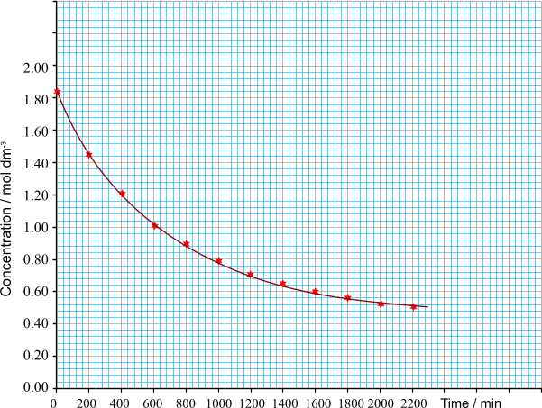
Graphical determination of rate
Higher level
The variation in rate can be investigated by measuring the change in concentration of one of the reactants or products, plotting a graph and then finding the gradients of the curve at different concentrations.
In the reaction…
A(aq) + B(aq) → C(aq) + D(aq)
the concentration of B was measured every 200 minutes. The reaction is obviously very slow!
RATE CALCULATION
The rate of reaction at any moment can be found from the gradient of the tangent at that point. The steeper the gradient, the faster the rate of reaction
Place a rule on the outside of the curve and draw a line as shown on the graph.
y
x
gradient = y / x

Slide 30
Higher level
concentration = 1.20 mol dm⁻³
gradient = - 1.60 mol dm⁻³
1520 min
rate = - 1.05 x 10⁻³ mol dm⁻³
The rate is negative because
the reaction is slowing down

Slide 31
1. Order – concentration vs time
Higher level
The order of reaction can be found by measuring the rate at different times during the reaction and plotting the rate against either concentration or time. The shape of the curve provides an indication of the order.
ZERO ORDER
A straight line showing a constant decline in concentration.
FIRST ORDER
A slightly sloping curve which drops with a constant half-life. (molecules harder to find)
CONCENTRATION (mol dm⁻³)
SECOND ORDER
The curve declines steeply at first then levels out.
TIME (s)

Slide 32
2. Order – rate vs concentration
Higher level
SECOND ORDER – the rate is proportional to the square of the concentration. You get an upwardly sloping curve.
ZERO ORDER – the rate does not depend on the concentration. The line is parallel to the x axis.
RATE OF REACTION / mol dm⁻³ s⁻¹
FIRST ORDER – the rate is proportional to the concentration so you get a straight line of fixed gradient. The gradient of the line equals the rate constant for the reaction.
CONCENTRATION / mol dm⁻³

Slide 33
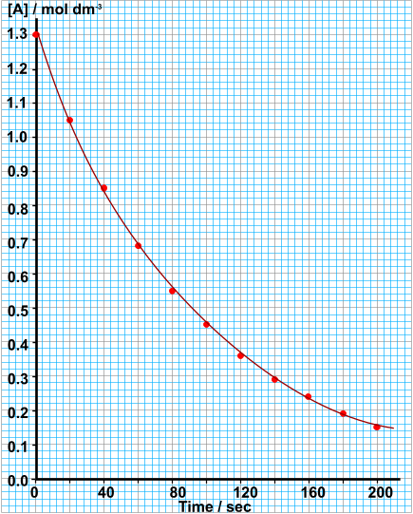
Higher level
ORDER OF REACTION
GRAPHICAL DETERMINATION
Calculate the rate of reaction at
1.0, 0.75, 0.5 and 0.25 mol dm⁻³
Plot a graph of rate v [A]
Calculate the time it takes
for [A] to go from...
1.00 to 0.50 mol dm⁻³
0.50 to 0.25 mol dm⁻³
Deduce from the graph
that the order wrt A is 1
Calculate the value and
units of the rate constant, k

Slide 34
Experimental determination of order
Higher level
Method 1 – Plotting a graph
Plot a concentration / time graph and calculate the rate (gradient) at points on the curve
Plot another graph of the rate (y axis) versus the concentration at that point (x axis)
If it gives a straight line, the rate is directly proportional to concentration - 1st ORDER.
If the plot is a curve then it must have another order. Try plotting rate v. (conc.) x 2.
A straight line would mean 2nd ORDER. This method is based on trial and error.
Method 2 - The initial rates method.
Do a series of experiments (at the same temperature) at different concentrations of a reactant but keeping all others constant. Plot a series of concentration/time graphs and calculate the initial rate (slope of curve at start) for each reaction. From the results calculate the relationship between concentration and rate and hence deduce the rate equation. To find order directly, logarithmic plots are required.
Notes:
Have students ask adv and disadv. Method 1 is quicker, but method 2 accounts for temperature.

Slide 35
Problem 1: In an experiment between A and B the initial rate of reaction was found for various starting concentrations of A and B. Calculate...
a. the individual orders for A and B
b. the overall order of reaction
c. the rate equation
d. the value of the rate constant (k)
e. the units of the rate constant
Higher level
Experiment | [A] | [B] | Initial rate (r)
1 | 0.5 | 1 | 2
2 | 1.5 | 1 | 6
3 | 0.5 | 2 | 8

Slide 36
Higher level
a. the individual orders for A and B
When [B] is kept constant [A] is tripled. The rate also triples (2 to 6). Therefore rate ∝ [A], so the order of reaction with respect to A is 1.
When [A] is kept constant [B] is doubled. The rate quadruples (2 to 8). Therefore rate ∝ [B]², the order of reaction with respect to B is 2.
b. the overall order of reaction
The overall order is the sum of the individual orders
= 1 + 2 = 3
Experiment | [A] | [B] | Initial rate (r)
1 | 0.5 | 1 | 2
2 | 1.5 | 1 | 6
3 | 0.5 | 2 | 8

Slide 37
c. the rate equation
By combining the two proportionality relationships you can construct the overall rate equation
∴ rate = k[A][B]²
d. the value of the rate constant (k)
k = $\frac{\text{rate} }{\text{[}\text{A}\text{][}\text{B}\text{]2} }$ = $\frac{\text{8} }{\text{(0.5}\text{)(0.2)}\text{2} }$ = 4
e. the units of the rate constant
Divide rate (mol.dm⁻³s⁻¹) by 3x concentration (mol.dm⁻³)
$\frac{\text{mol} \text{dm}\text{−3} \text{s}\text{−1}}{\text{mol}\text{3} \text{dm}\text{−}\text{9}}$ = $\frac{\text{mol} \text{dm}\text{−3} \text{s}\text{−1}}{\text{mol}\text{3} \text{dm}\text{−}\text{9}}$ = $\frac{\text{s}\text{−1}}{\text{mol}\text{2 }\text{dm}\text{−}\text{6}}$ = $\text{dm}\text{6} \text{mo}\text{l}\text{−2 }\text{s}\text{−1}$
∴ k = 4 $\text{dm}\text{6 }\text{mo}\text{l}\text{−2 }\text{s}\text{−1}$
Higher level

Slide 38
Reaction Mechanisms
Higher level
Reactions may occur all at once or through several discrete steps.
In a multistep process, one of the steps will be slower than all others.
The overall reaction cannot occur faster than this slowest, rate-determining step.
The order of reaction for this step will be the same as the order of reaction for the entire reaction
38.

Slide 39
Slow Initial Step
Higher level
NO₂(g) + CO(g) → NO(g) + CO₂(g)
The rate law for this reaction is found experimentally to be
Rate = k [NO₂]²
CO is necessary for this reaction to occur, but the rate of the reaction does not depend on its concentration.
This suggests the reaction occurs in two steps.
39.

Slide 40
Slow Initial Step
Higher level
A proposed mechanism for this reaction is
Step 1: NO₂ + NO₂ ⎯⎯→ NO₃ + NO (slow)
Step 2: NO₃ + CO ⎯⎯→ NO₂ + CO₂ (fast)
The NO₃ intermediate is consumed in the second step.
As CO is not involved in the slow, rate-determining step, it does not appear in the rate law.
40.

Slide 41
Molecularity of the reaction mechanism
Higher level
Unimolecular steps involve a single species as a reactant.
A → / Products
Bimolecular steps involve collisions of two species (that form a transition state or an activated complex that cannot be isolated).
A + B → / Products

Slide 42
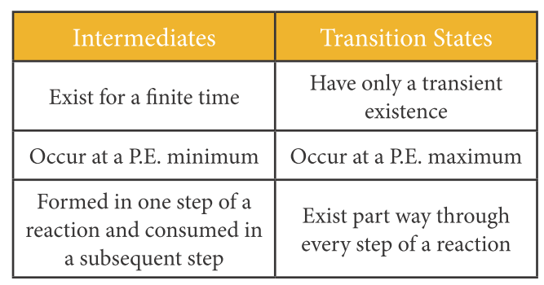
Differences between intermediates and transition states
Higher level

Slide 43
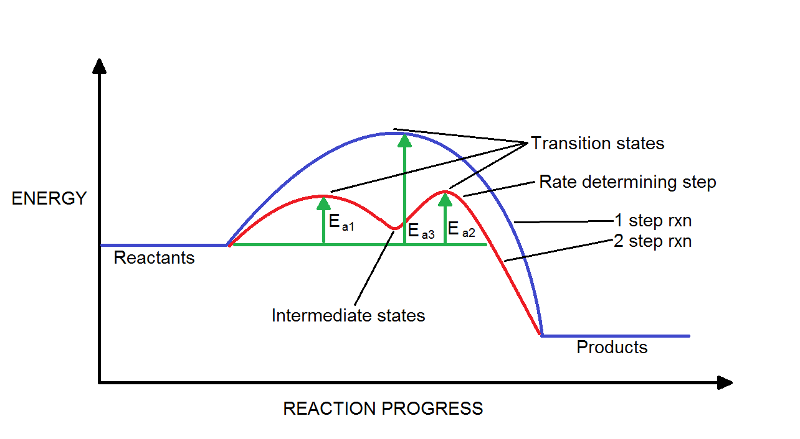
Higher level
Differences between intermediates and transition states
43.

Slide 44
Determining order of reaction from reaction mechanism
Higher level
For the following assume a bimolecular reaction:
A + B → C + D
Use the rate limiting step and in the reaction mechanism to determine the reaction order of the reaction in the preceding slides...
Notes:
Rate determined by slowest step

Slide 45
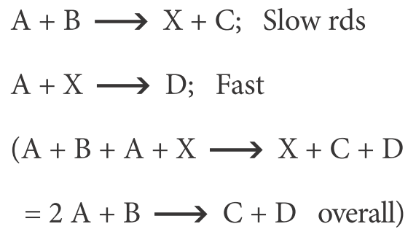
Determining order of reaction from reaction mechanism
Higher level
Mechanism
Rate expression (overall order)
r = k[A][B]
Order = 2
Notes:
Rate determined by slowest step

Slide 46
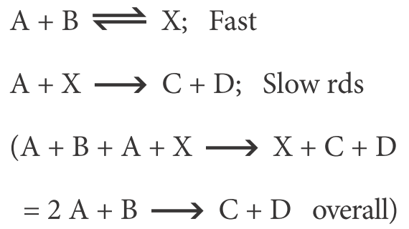
Determining order of reaction from reaction mechanism
Higher level
Mechanism
Rate expression (overall order)
r = k[A][X]
= k[A][A][B]
= k[A]²[B]
Order = 3
X does not exist in the initial reaction.
Notes:
Rate determined by A and X, but X determined by A and B also, therefore A A B.

Slide 47
Determining order of reaction from reaction mechanism
Higher level
Mechanism
Rate expression (overall order)
r = k[A]²
Order = 2

Slide 48
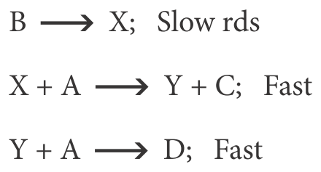
Determining order of reaction from reaction mechanism
Higher level
Mechanism
Rate expression (overall order)
r = k[B]
Order = 1
Notes:
Rate only determined by B

Slide 49
Determining order of reaction from reaction mechanism
Higher level
Mechanism
Rate expression (overall order)
r = k[A₂][B]
= k[A][A][B]
= k[A]²[B]
Order = 3
B must exist in the initial reaction.

Slide 50
Guessing the rate determining steps (RDS)
Higher level
Determine possible mechanism
See which fits the rate equation
Example: A + B + C → ABC rate = k[A][B]
What is the mechanism and RDS?
Hint: The chances of 3 substance all hitting at the right place at the same time is unlikely….so…
1. A + B → AB, then AB + C → ABC or
2. A + C → AC, then AC + B → ABC or
3. B + C → BC, then BC + A → ABC
As C is zero order and the rate is first order A and B, situation 1 seems most likely, with the first reaction the RDS.

Slide 51
Problem 1: 2N₂O → 2N₂ + O₂ rate = k[N₂O]², what is the RDS?
Higher level
1. 2N₂O → N₂ + O₂ rate agrees or
2. N₂O → N₂ + O (if RDS then rate disagrees here)
then N₂O + O → N₂ + O₂ Must be RDS
rate = [N₂O][O]
= [N₂O][N₂O]
= [N₂O]² rate agrees too!

Slide 52
16.2 Activation energy
Higher level
OBJECTIVES
• The Arrhenius equation uses the temperature dependence of the rate constant to determine the activation energy.
• A graph of 1/T against ln k is a linear plot with gradient – E_{a}/R and intercept, lnA.
• The frequency factor (or pre-exponential factor) (A) takes into account the frequency of collisions with proper orientations.
• Analysing graphical representation of the Arrhenius equation in its linear form .
•Using the Arrhenius equation .
• Describing the relationships between temperature and rate constant; frequency factor and complexity of molecules colliding.
• Determining and evaluating values of activation energy and frequency factors from data.

Slide 53
Math revision logs
b = a^{c} can be described as c = log_{a}b “b to base a is c”
Eg. 8 = 2³
The two most common are logs:
base 10 = log(x), or log₁₀(x), or lg(x)
base e (2.718...) = log_{e}(x), or ln(x) ‘’natural log”

Slide 54
Arrhenius Equation
Higher level
Svante Arrhenius developed a mathematical relationship between k and E_{a}:
where A is the frequency factor (or Arrhenius constant), a number that represents the likelihood that collisions would occur with the proper orientation for reaction. E_{a} is the activation energy. T is the Kelvin temperature and R is the universal thermodynamics (gas) constant.
R = 8.314 J mol⁻¹ K⁻¹ or 8.314 x 10⁻³ kJ mol⁻¹ K⁻¹
54.

Slide 55
Higher level
Arrhenius plot: ln(k) vs 1/T
Taking the natural logarithm of both sides, the equation becomes
1
RT
y = mx + b
When k is determined experimentally at several temperatures, E_{a} can be calculated from the slope of a plot of ln k vs. 1/T.
55.

Slide 56
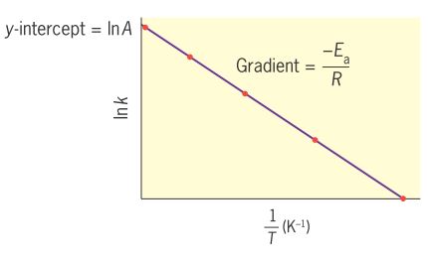
Determining E_{a}
Higher level
Convert the rate constants (k) to natural logs: ln(k)
Convert temperatures to Kelvin by adding 273 and then convert them to 1/T
Draw an Arrhenius plot of ln(k) vs 1/T
Measure the gradient of the line (y = mx + c)
Gradient = -E_{a}/R
Solve for E_{a}

Slide 57
Rule of thumb
Higher level
For most equations, an increase of 10°C will double the rate of the reaction.
57.

Slide 58
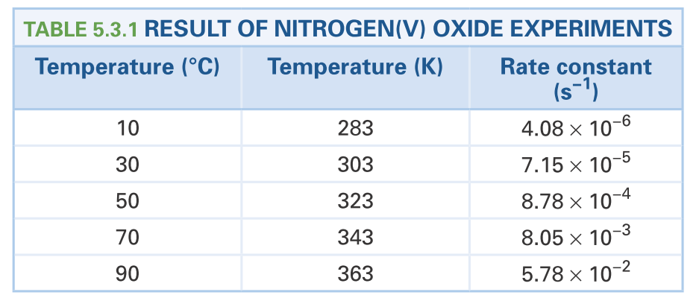
Higher level
Problem 1: Use a graphical method to determine E_{a}

Slide 59
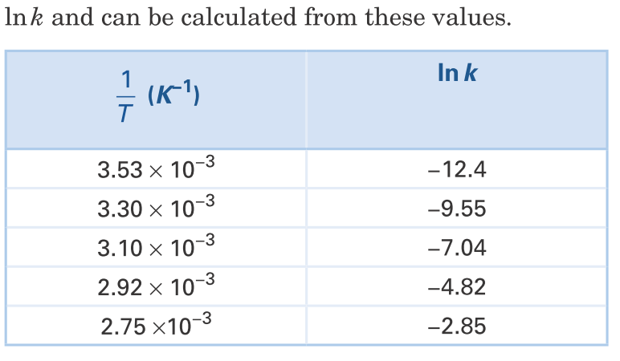
Answer:
Higher level

Slide 60
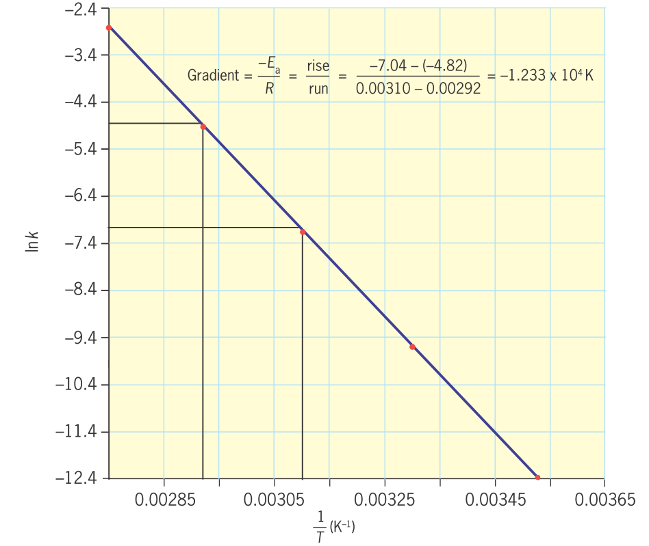
Higher level

Slide 61
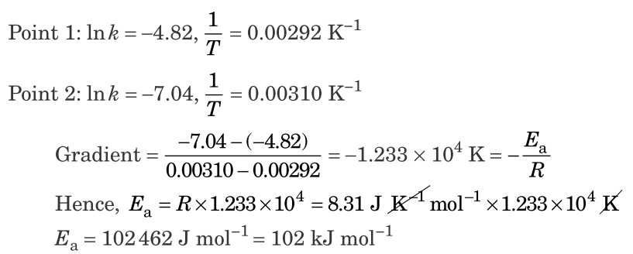
Higher level

